Slide 1

Self-introduction Of Doctoral Application
Applicant: Zhongqi Xiu
Application for Bai’s lab

Slide 2
OUTLINE
1. Personal Introduction
2. Research Experience And Results
3. Doctoral Research Plan

Slide 3
01.
Personal Introduction

Slide 4

Personal Information
Name: Zhongqi Xiu
GPA: 87/100
English level: TOEFL: 99
Major: Optics and optical engineering
Key courses taken:
Quantum Mechanics (95)
Engineering Optics* (94)
Advanced Photon Physics* (93)
Computer Programming (95)
Research Interest
Optical imaging
Cavity QED
Optical characteristics of 2D materials
High-Resolution Optical Imaging and Sensing (quantum emitters)
Based on the fiber and cold atoms
Especially transition metal dichalcogenides

Slide 5
Resume
Honors
Outstanding Student Scholarship, Silver Prize (Top 10%)
Endeavor Scholarship (Top 5%)
Chung-Yao Chao Talent Program Scholarship
Publication
Approaching the intrinsic purity of single photon emitter in atomically thin semiconductor
Wenjing Wu, Zhongqi Xiu, Hangzheng Shen, Song Liu, James C. Hone, Junichiro Kono, Shengxi Huang*.
Teaching assistant
Optics B (Fall 2023)
Instructor: Prof. Zheng Xi ; Credit 3 ; Class: 58 juniors ;
Skills
Programming Languages: Python, C/C++, HTML/CSS
Frameworks and Software: Anaconda, MATLAB, Solidworks, LabVIEW, Keil, COMSOL

Slide 6
02.
Research Experience And Results

Slide 7
Research Experience
Single atom trapping based on movable optical lattices
2022.09～2024.06
Achieved the trapping of single atoms and combine fluorescence detection to achieve high-precision control of atomic positions by movable optical lattice.
Combination of the cavity cooling and feed back cooling to reach temperature limit
2024.03～Present
Calculated the combination of 2 cooling methods and certified that the new method’s lowest temperature has the correct positive correlation with a low cavity decay rate.
Single photon emission in 2D materials
2024.07～Present
Designed and fabricated substrates with strain engineering features
Carried out optical spectroscopy measurements including photoluminescence , Raman, Time-Correlated Single Photon Counting on hBN encapsulated monolayer.

Slide 8
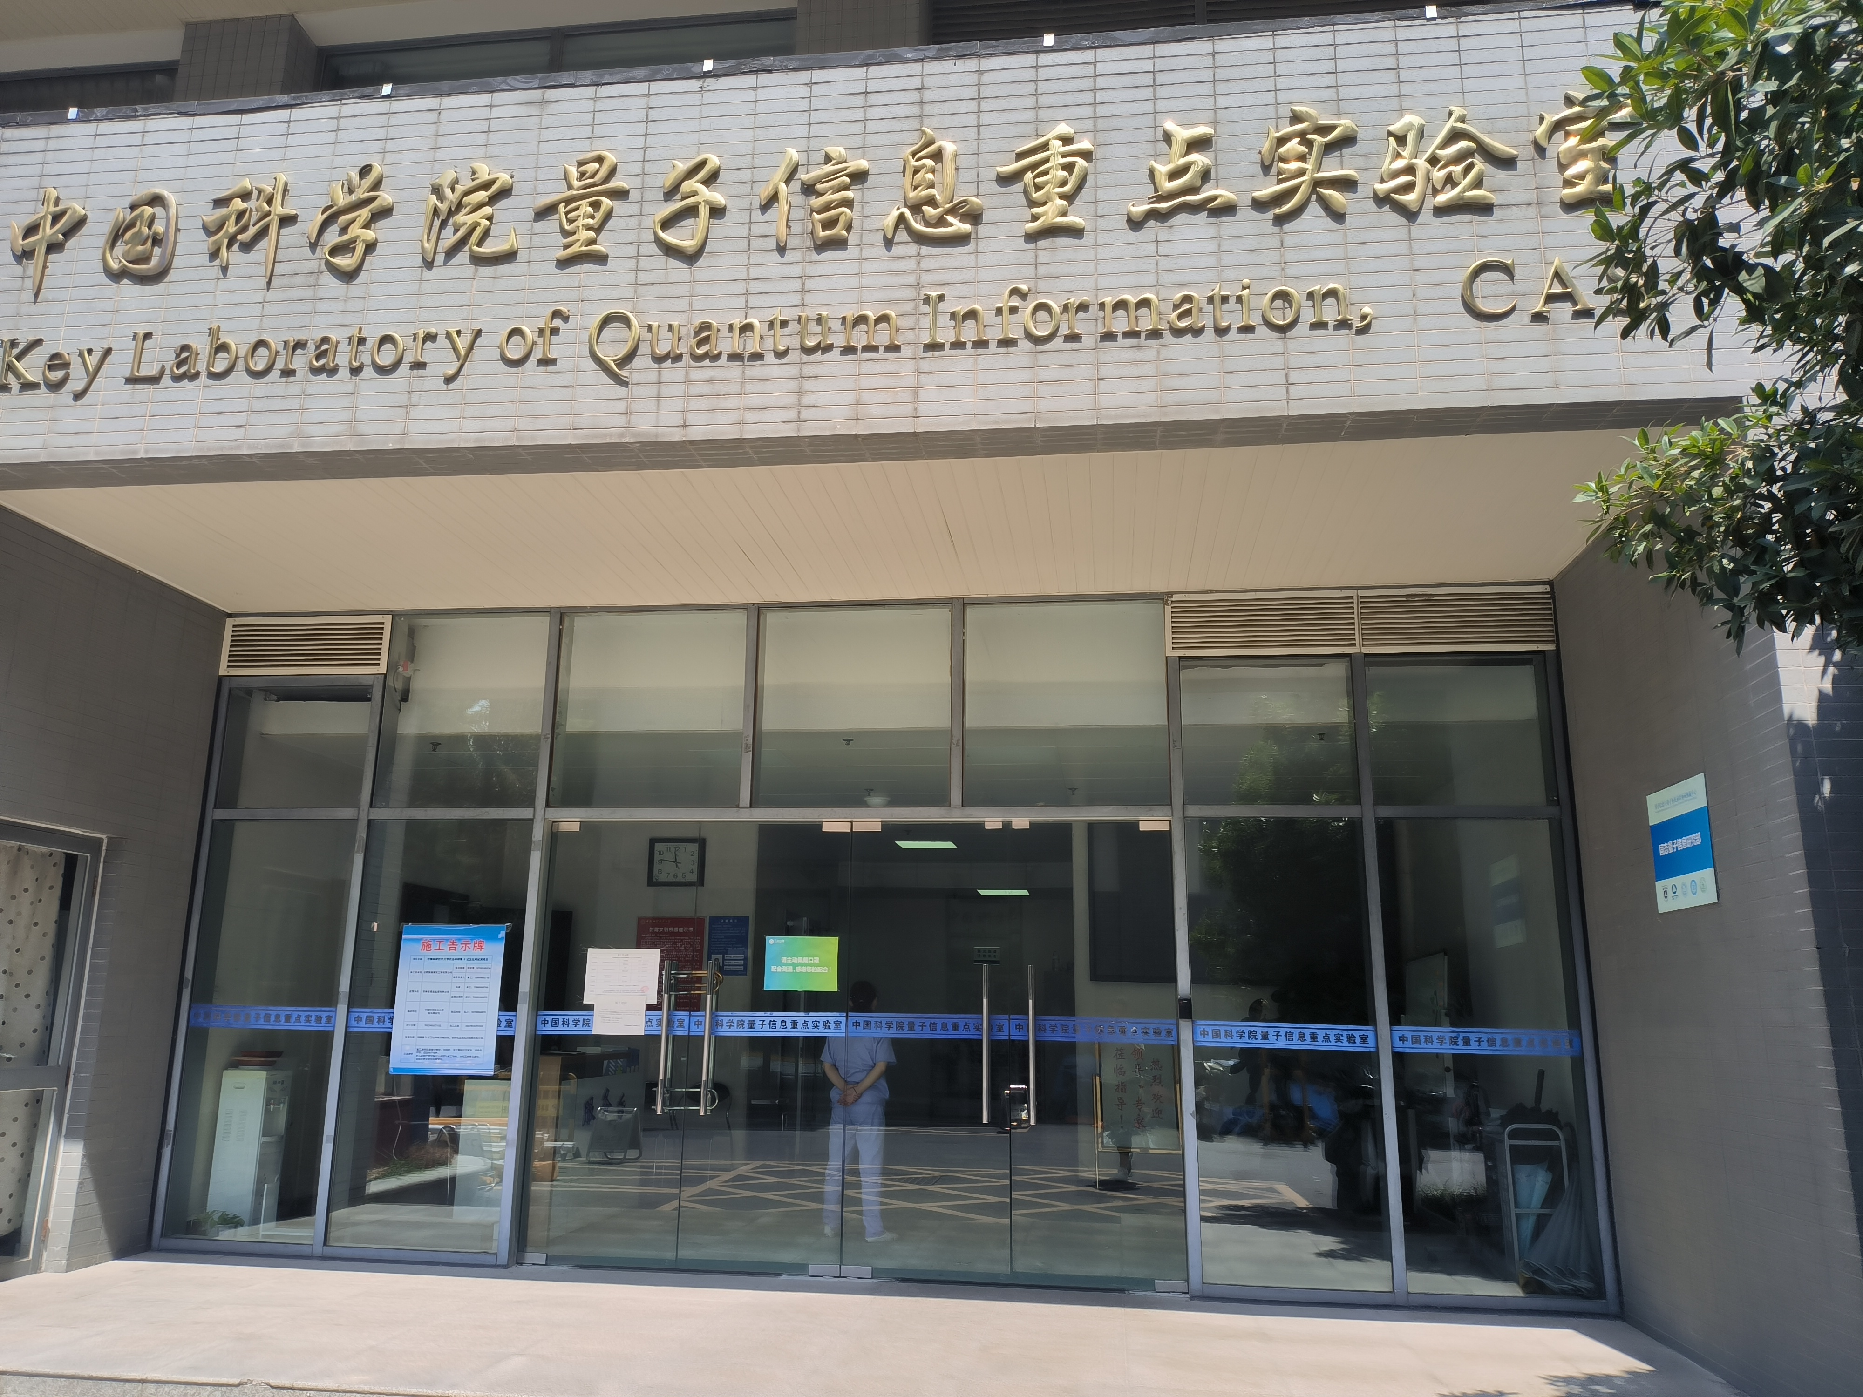
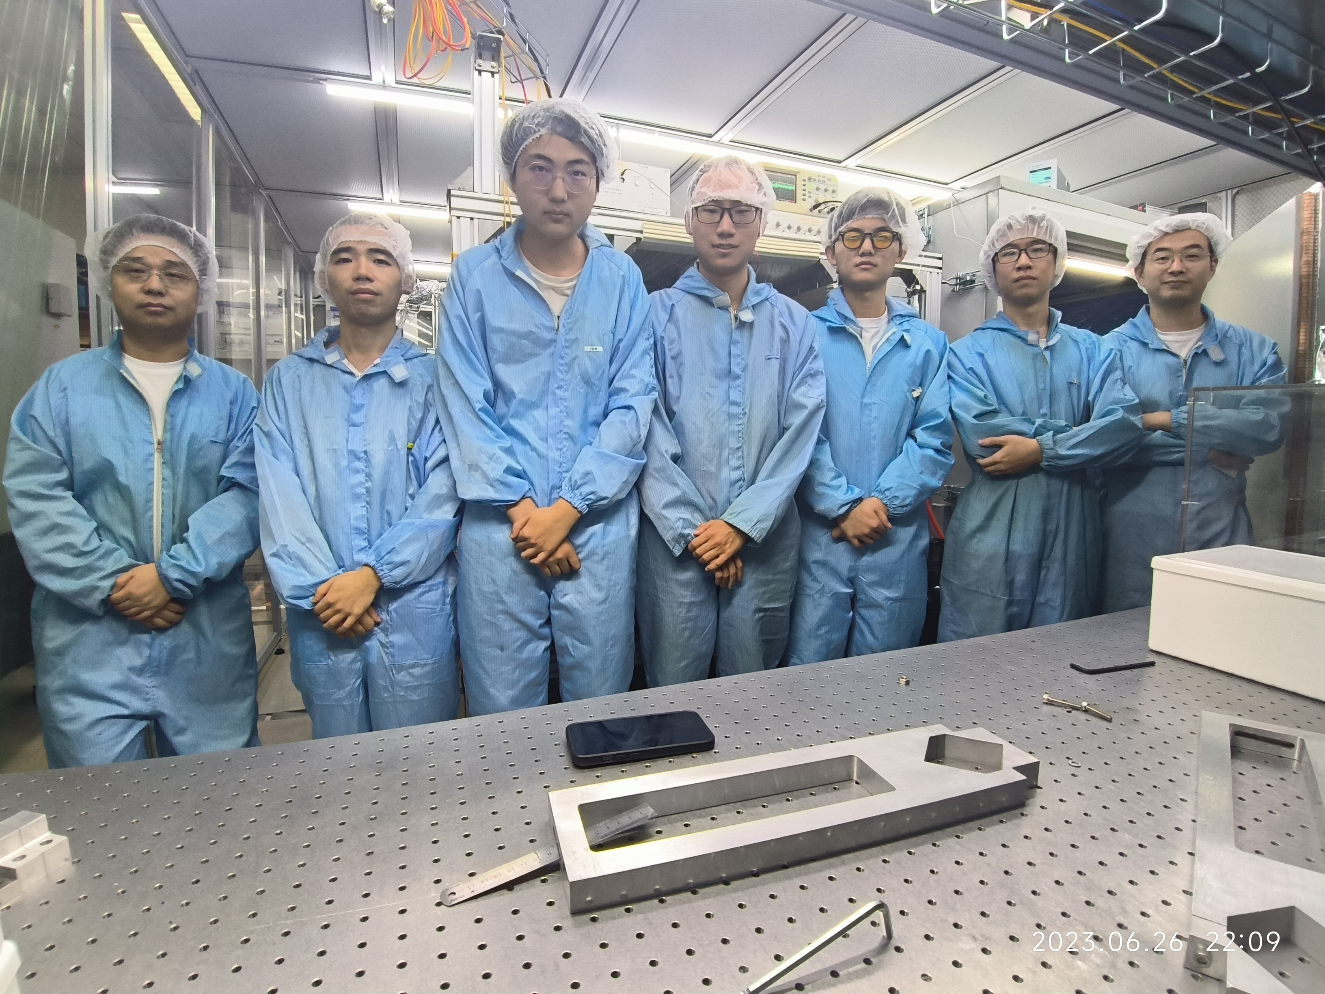
Atom trapping based on optical lattices
(1) Single atom trapping based on movable optical lattices
Research Group: Fiber Cavity QED group supervised by Prof. Chuan-Feng Li
Key Laboratory of Quantum Information, CAS
Proposed to achieve the trapping of single atoms and combine fluorescence detection to achieve high-precision control of atomic positions by movable optical lattice.

Slide 9
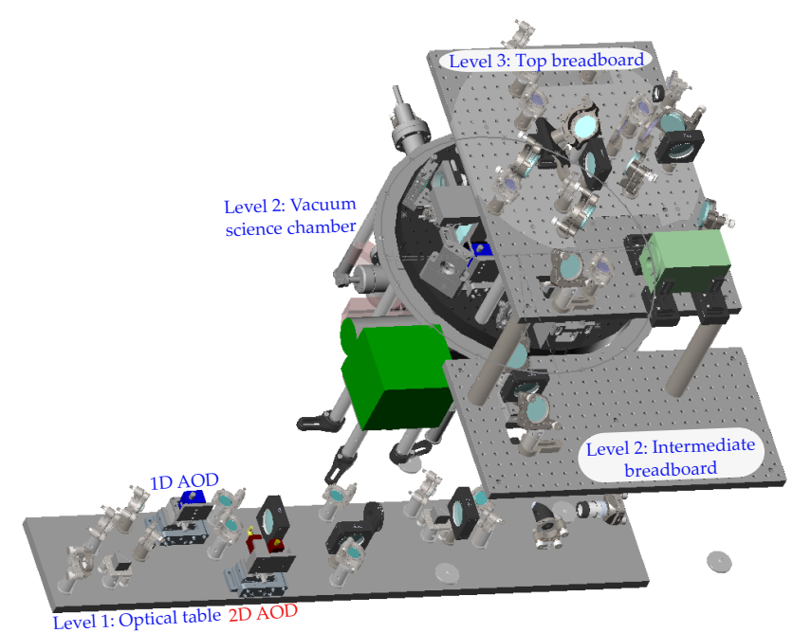
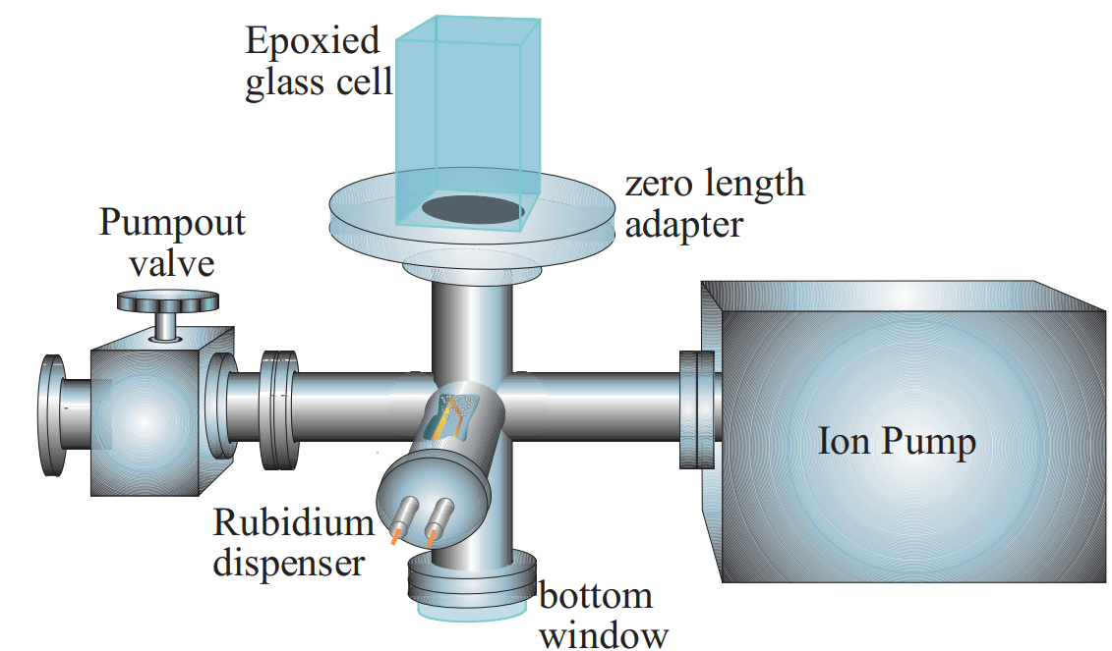
Atom trapping based on optical lattices
Led building and cleaning our second ultrahigh optical vacuum system
We mounted a Rb atom dispenser for the MOT and optical dipole traps for ensembles and single atoms.
The vacuum degree of the system has reached 3×10−11Torr.
Optica 4, 576-579 (2017)

Slide 10
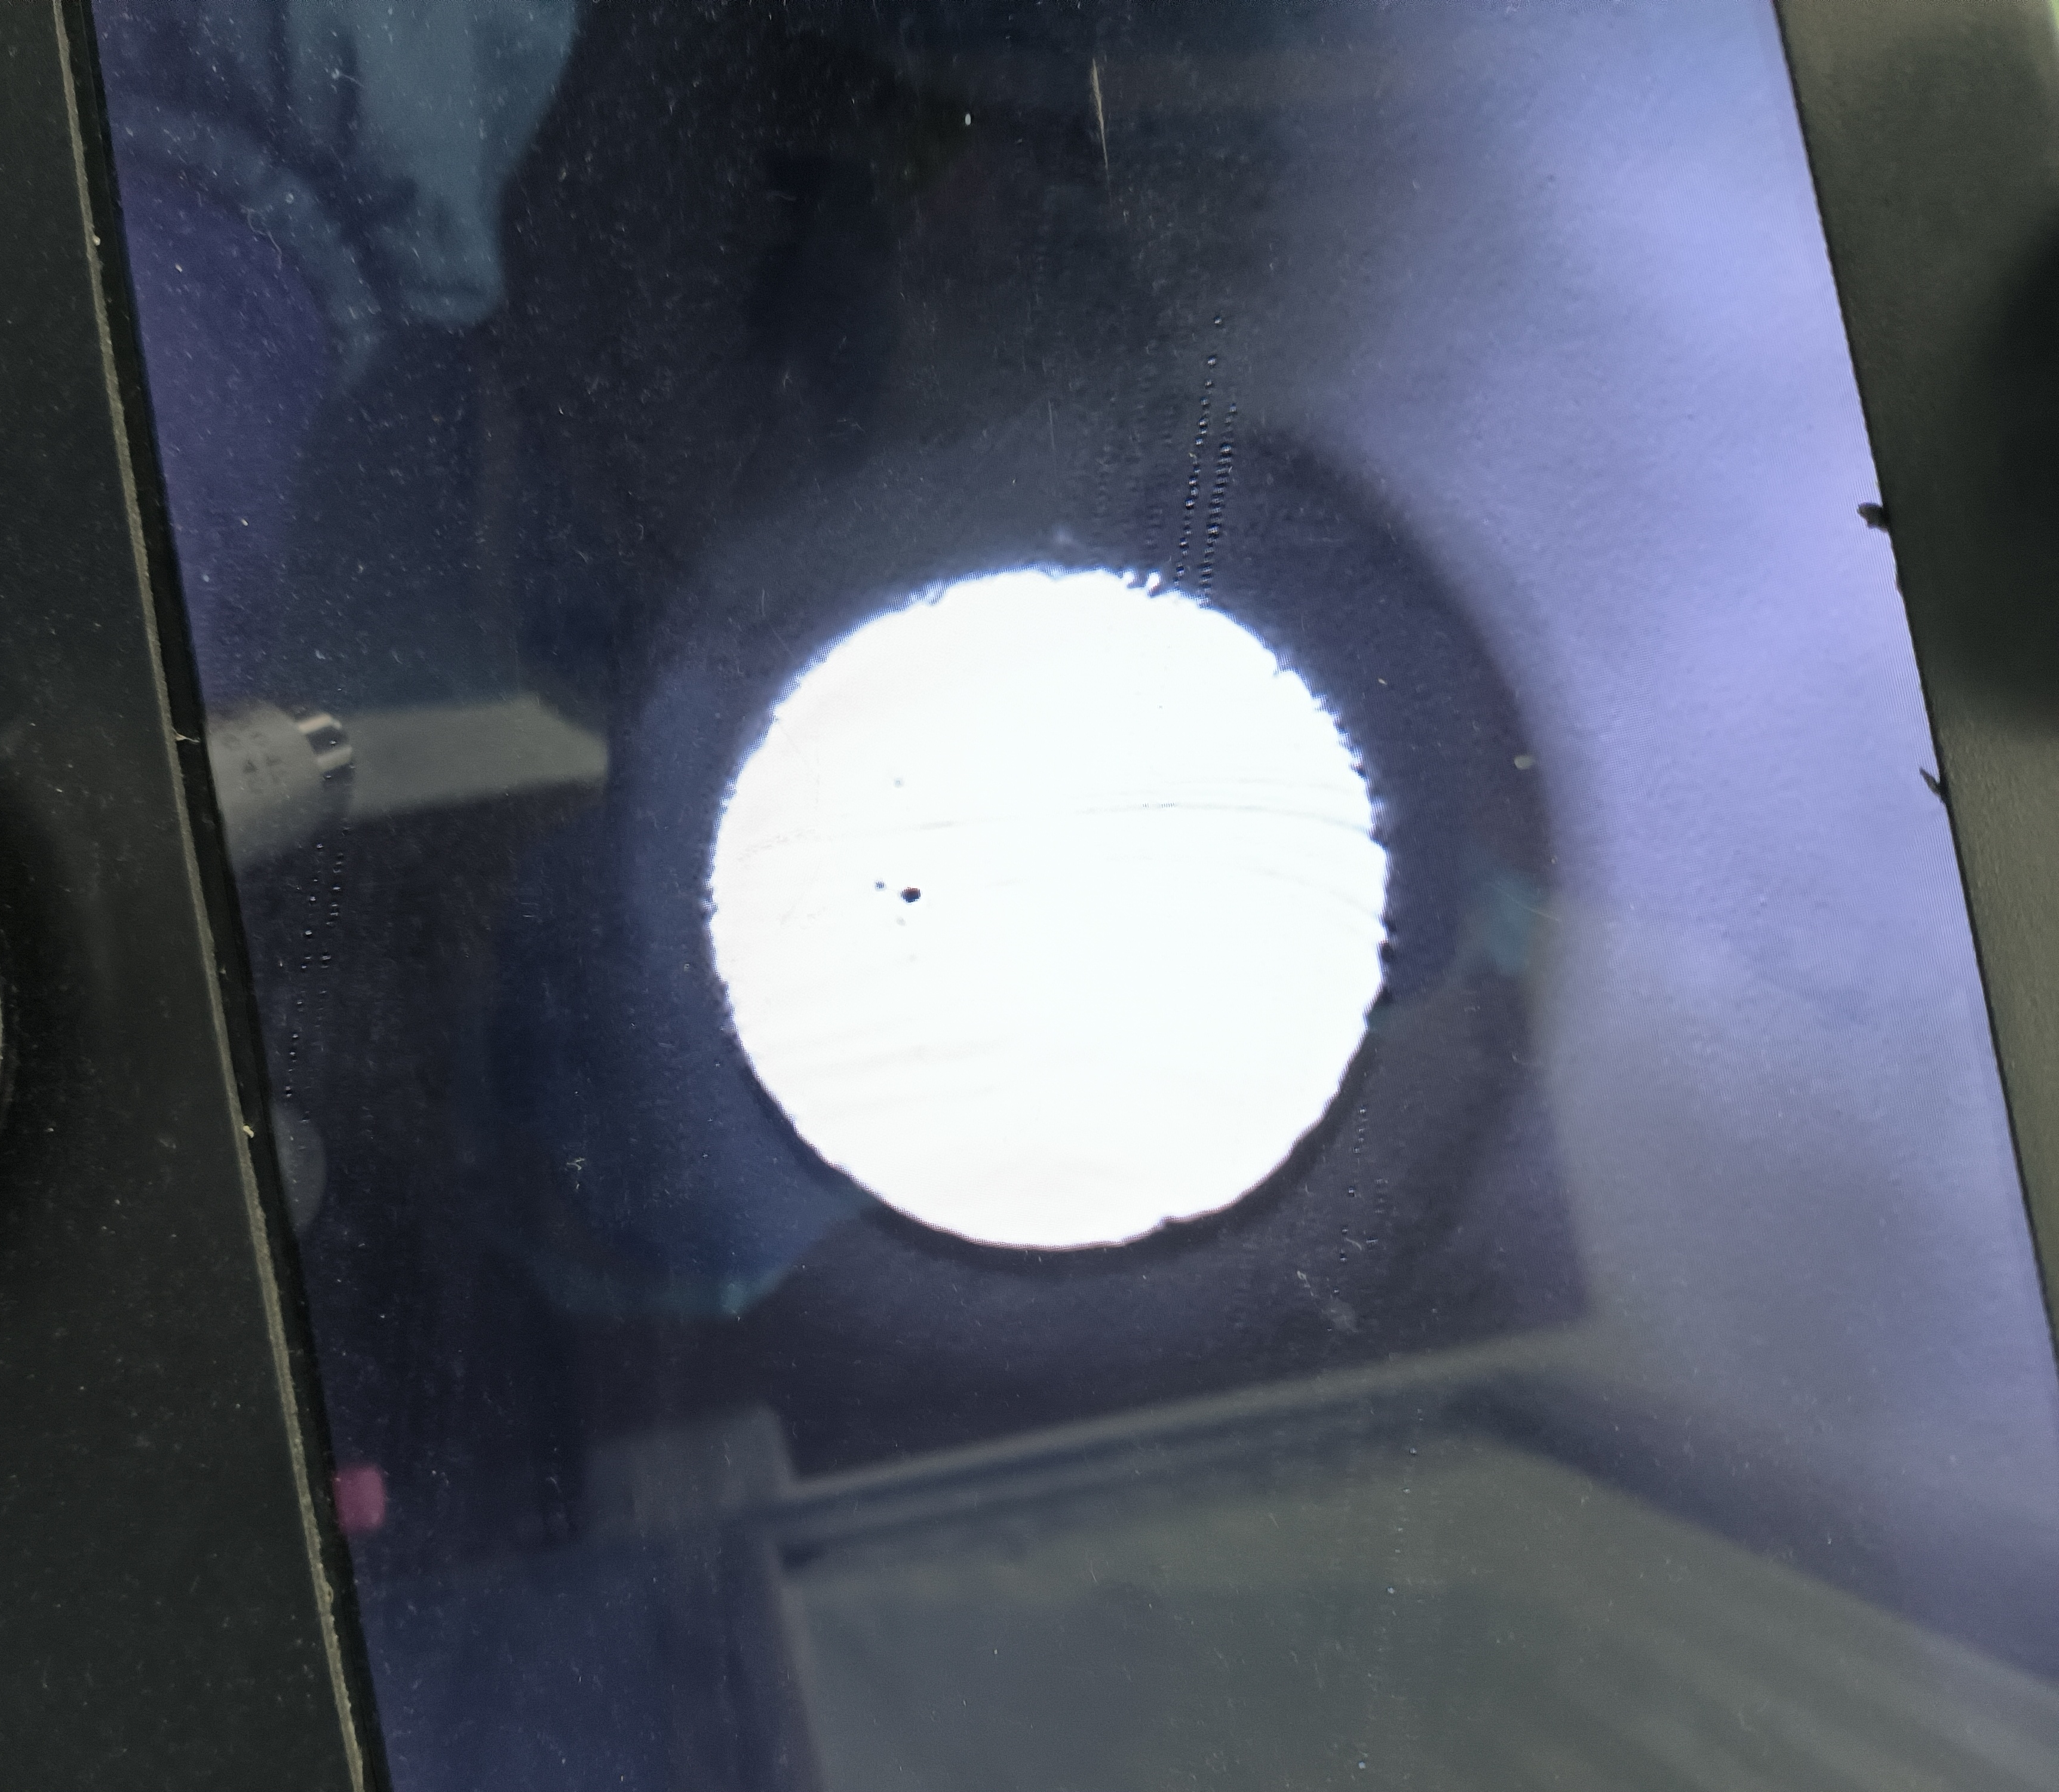
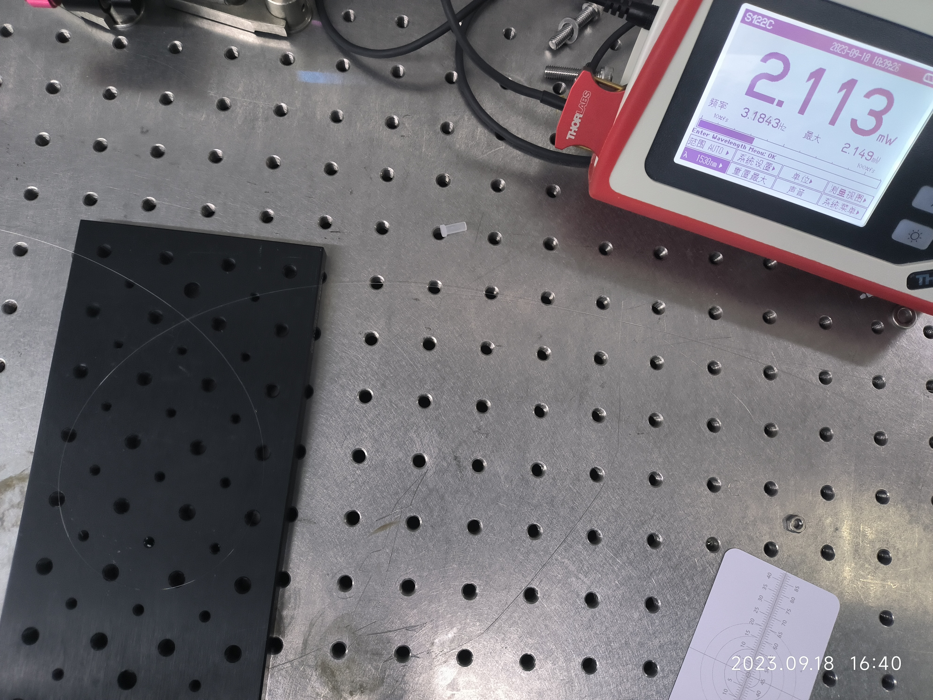
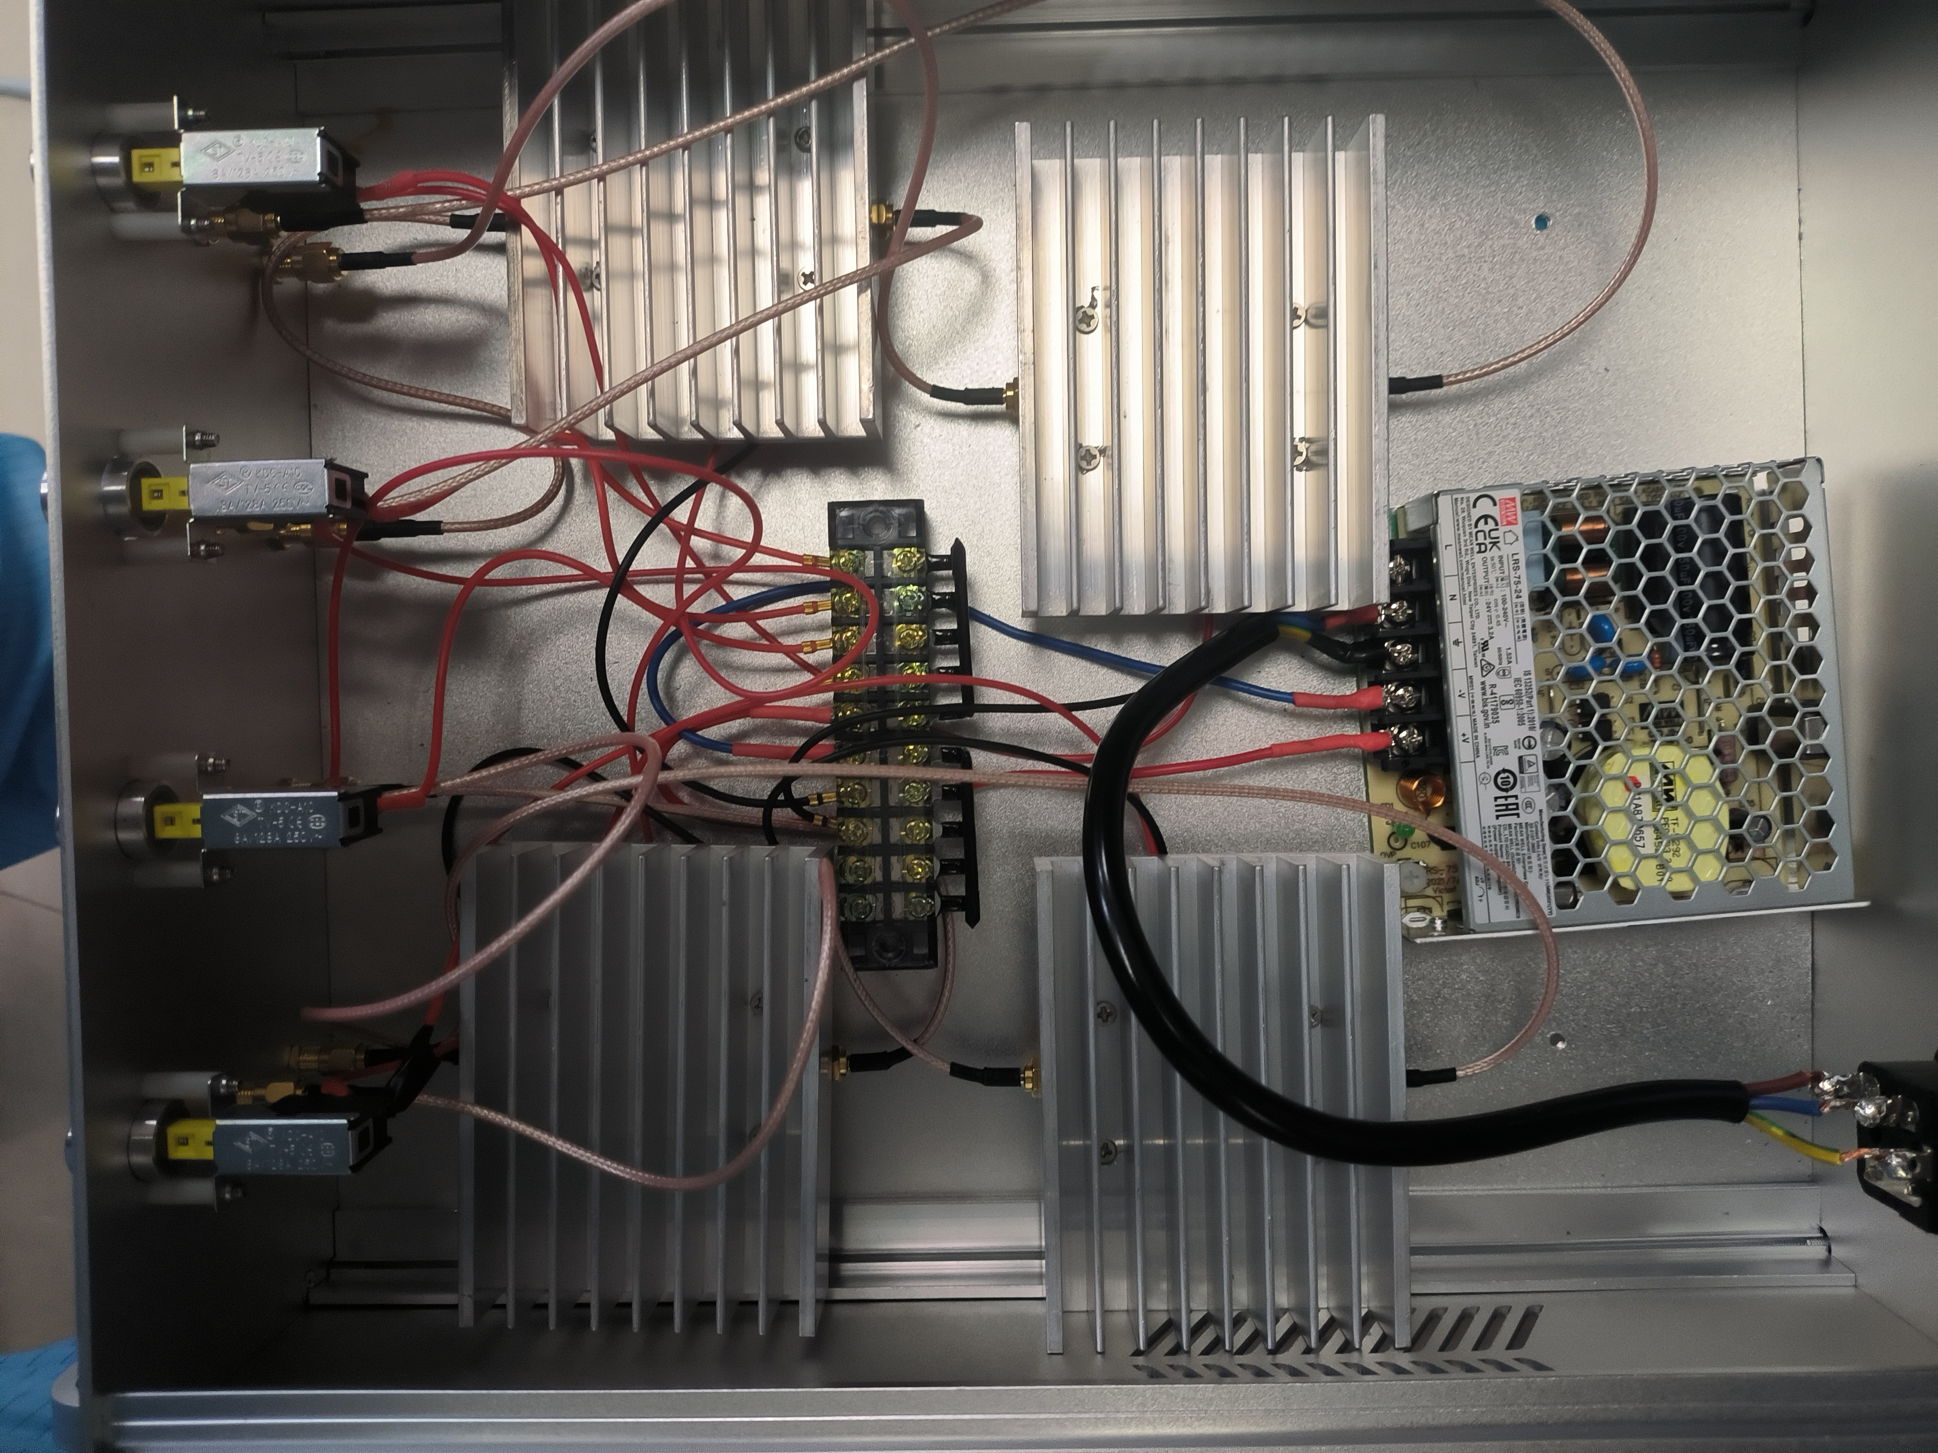
Atom trapping based on optical lattices
Independently pre-treated the optical fiber which will be used in the vacuum system and tested the mode field diameter of treated single mode fiber to optimize the mode matching between the modes of cavity and fiber.
Independently designed control circuits and installed control electronics such as the microwave amplifier, radio frequency switch, and radio frequency generator into multiple integrated chassis to facilitate the connection of electrical devices in the optical path.
Notes:
改变涂覆层 使用laser烧制腔体

Slide 11
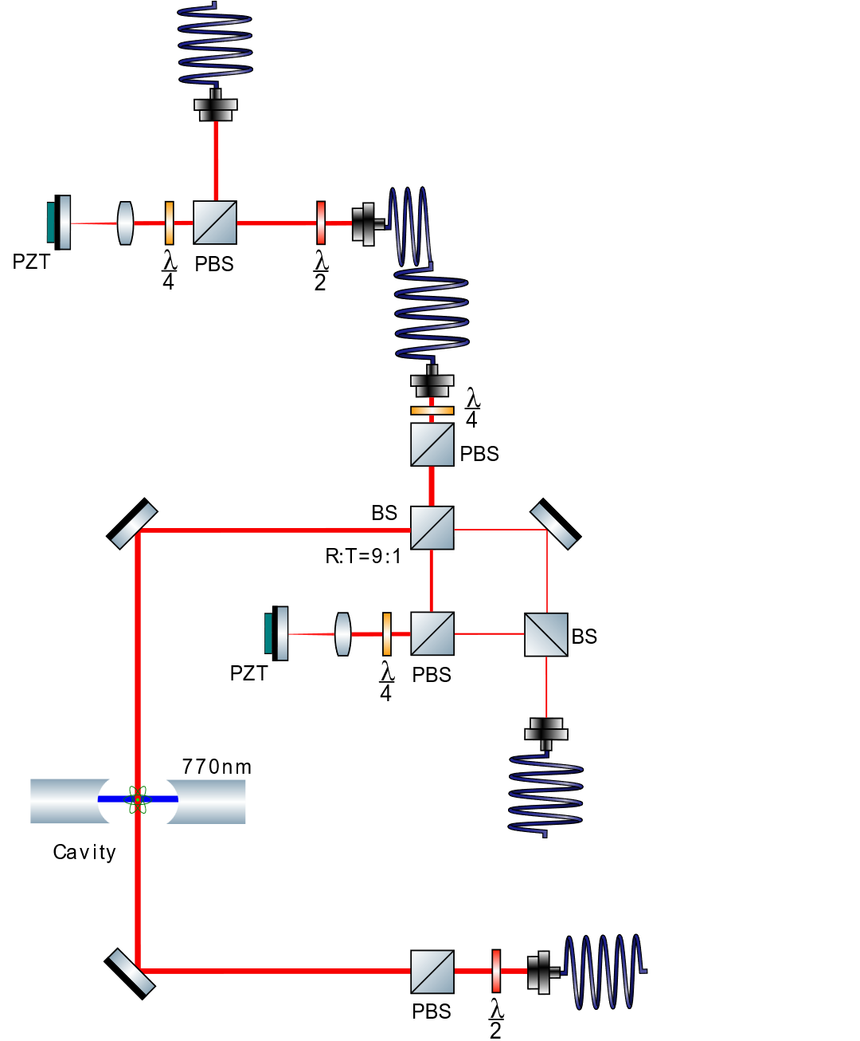
Atom trapping based on optical lattices
Atomic Loading Process - Light Sequence:
Prepare the atomic cloud above the cavity (3 mm MOT), cooling to ~16 uK.
Turn off the MOT and release the atomic cloud.
One vertical 850 nm light beam (passing through the cavity center) guides the atomic cloud to fall.
3a. Two counter-propagating cooling beams (slightly tilted and vertically polarized).
3b. Two counter-propagating horizontal beams form the optical lattice; fine-tune the lattice position.
4.A vertical beam in the opposite direction forms a vertical optical lattice; fine-tune the position of the lattice.
Notes:
改变涂覆层 使用laser烧制腔体

Slide 12
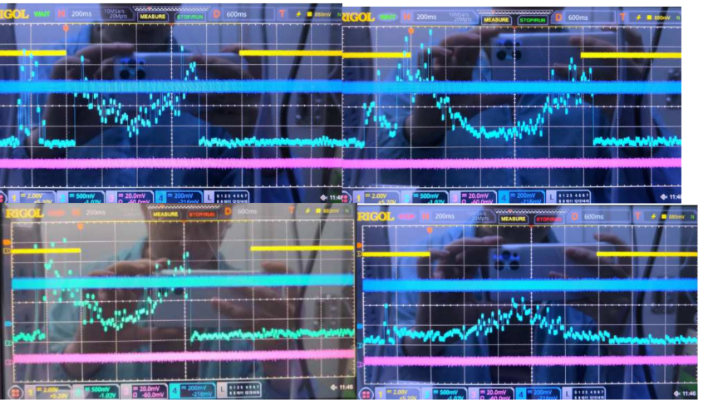
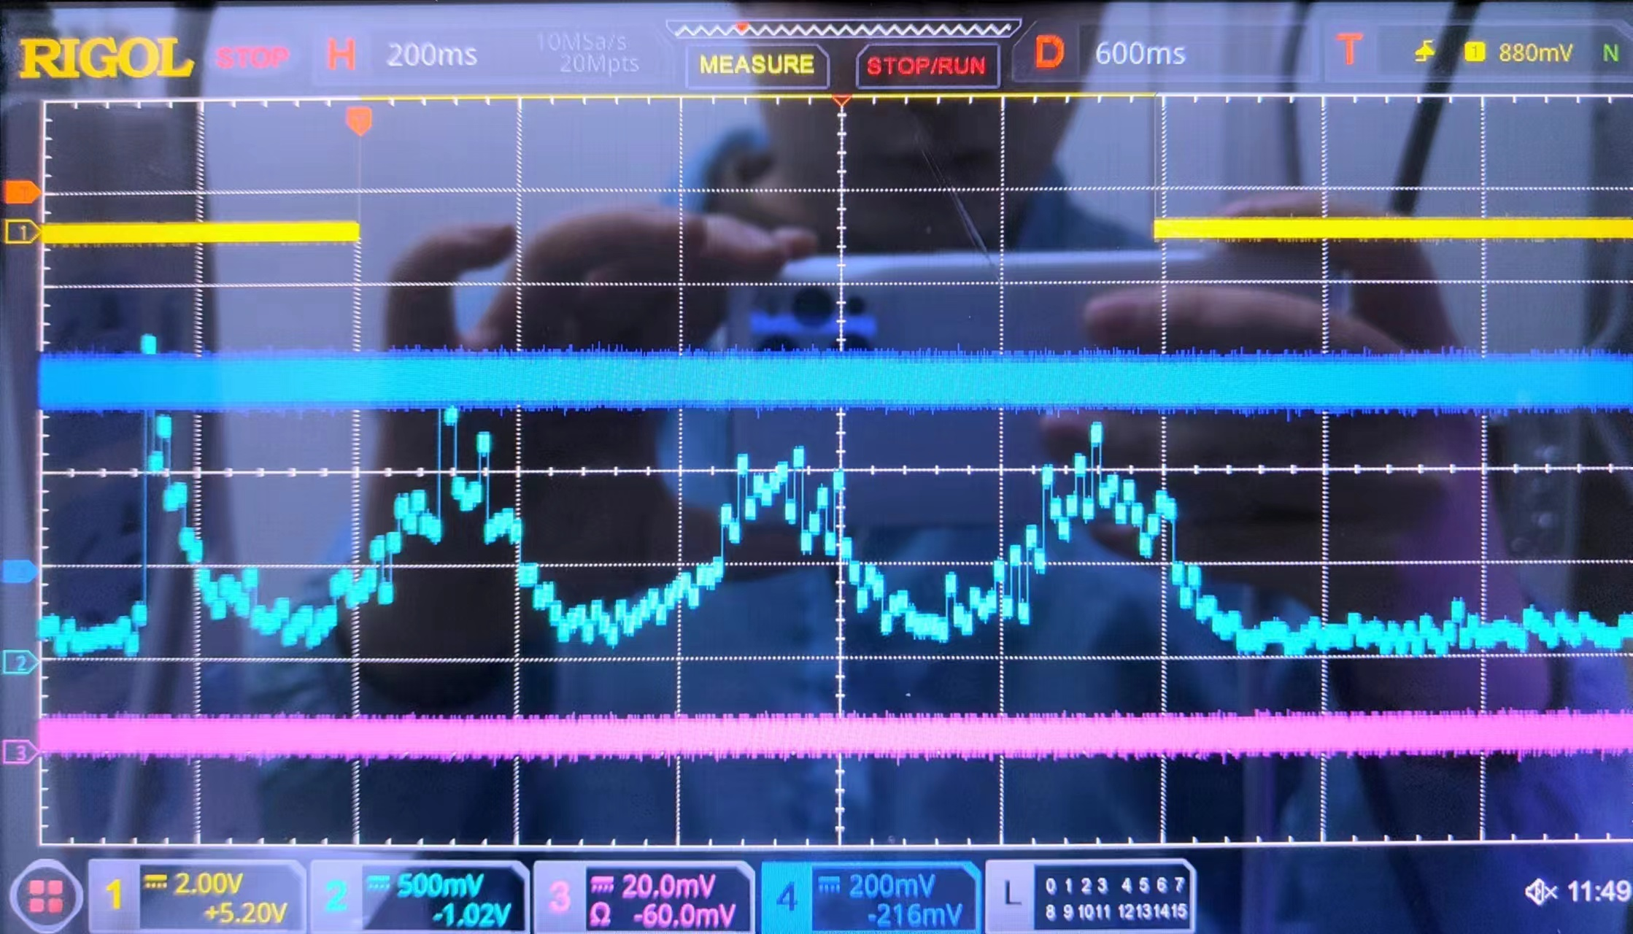
Atom trapping based on optical lattices
Keep ramp, change the period of DDS, add FPGA to the voltage feedback.
Atom trap in lattice
Yellow: trigger voltage
Blue: fluorescence signal from atom
Also we test about the trapping time to 3s (depends on the fluorescence signal)
Notes:
How to explain this ?

Slide 13
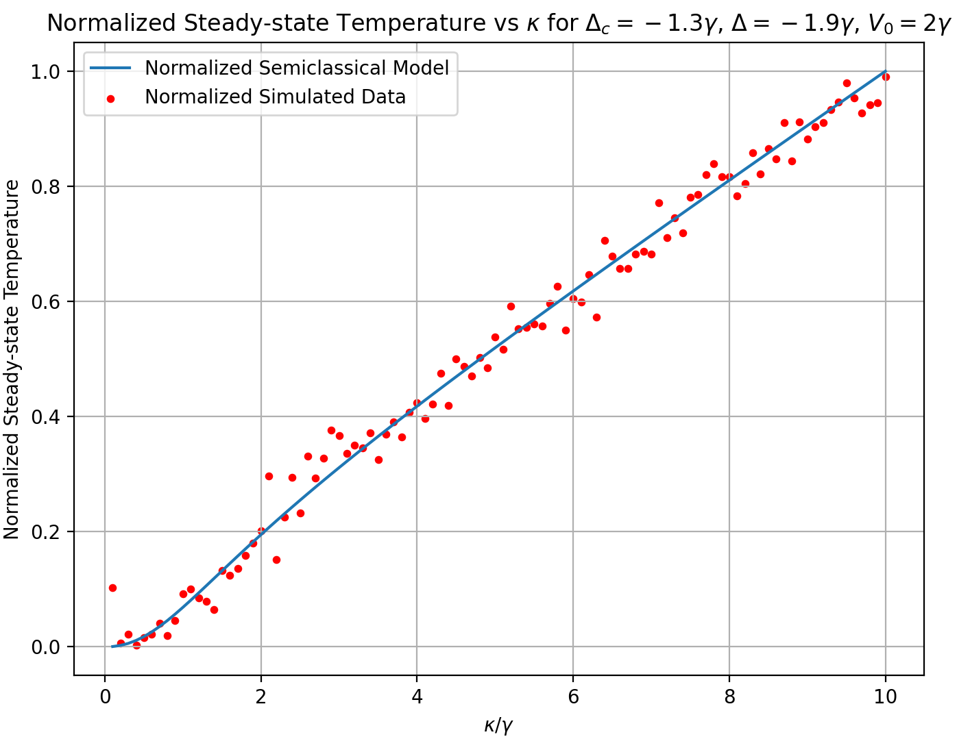
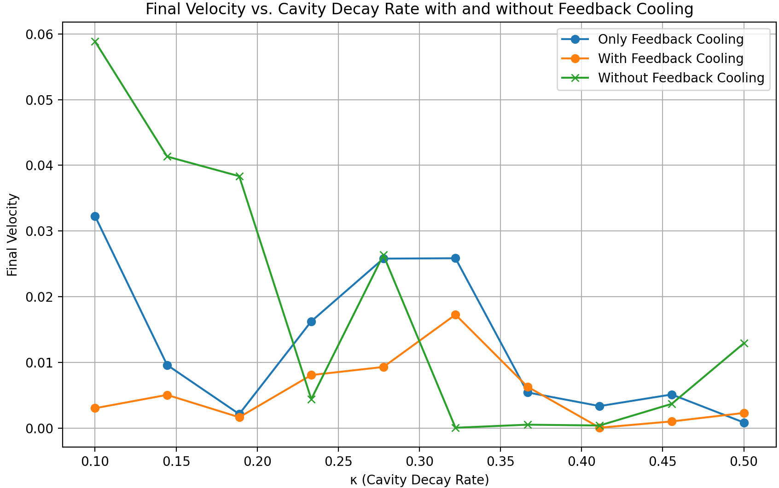
Combination of cooling methods
(2) Combination of two atom cooling methods to reach temperature limit
Research Group: Fiber Cavity QED group supervised by Prof. Chuan-Feng Li
First try to use simply Langevin equation

Slide 14
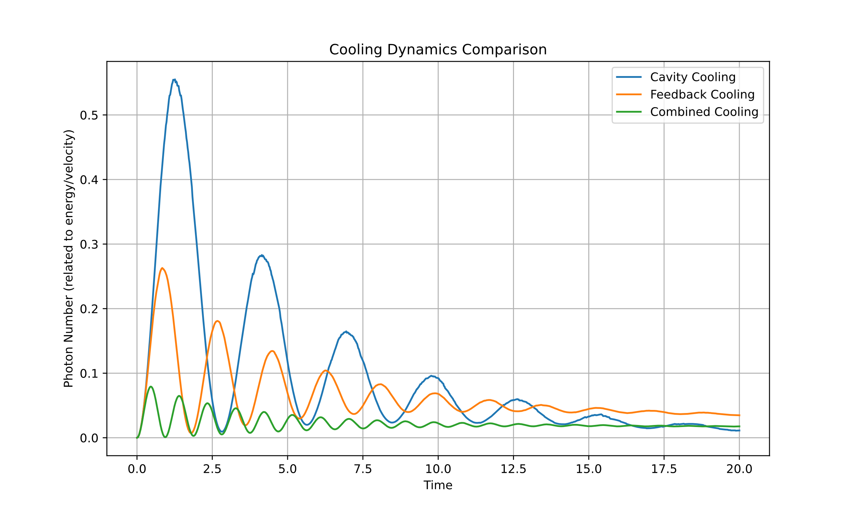
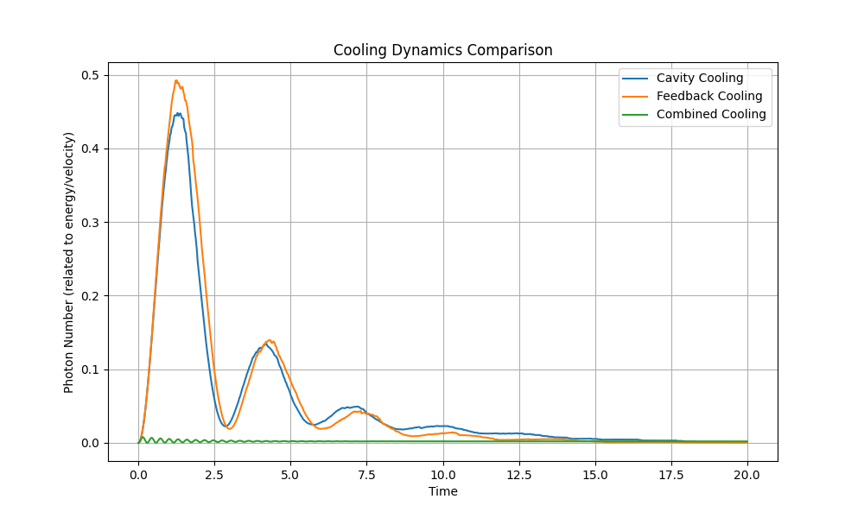
Combination of cooling methods
Then try to solve master equation and Stochastic Schrödinger Equation for Quantum Monte Carlo
What we can do using the system: apply the new cooling method to our Rb system to reach lower temperature
In the future (probably next year), we’ll deploy the new method to our existing system to comfirm

Slide 15

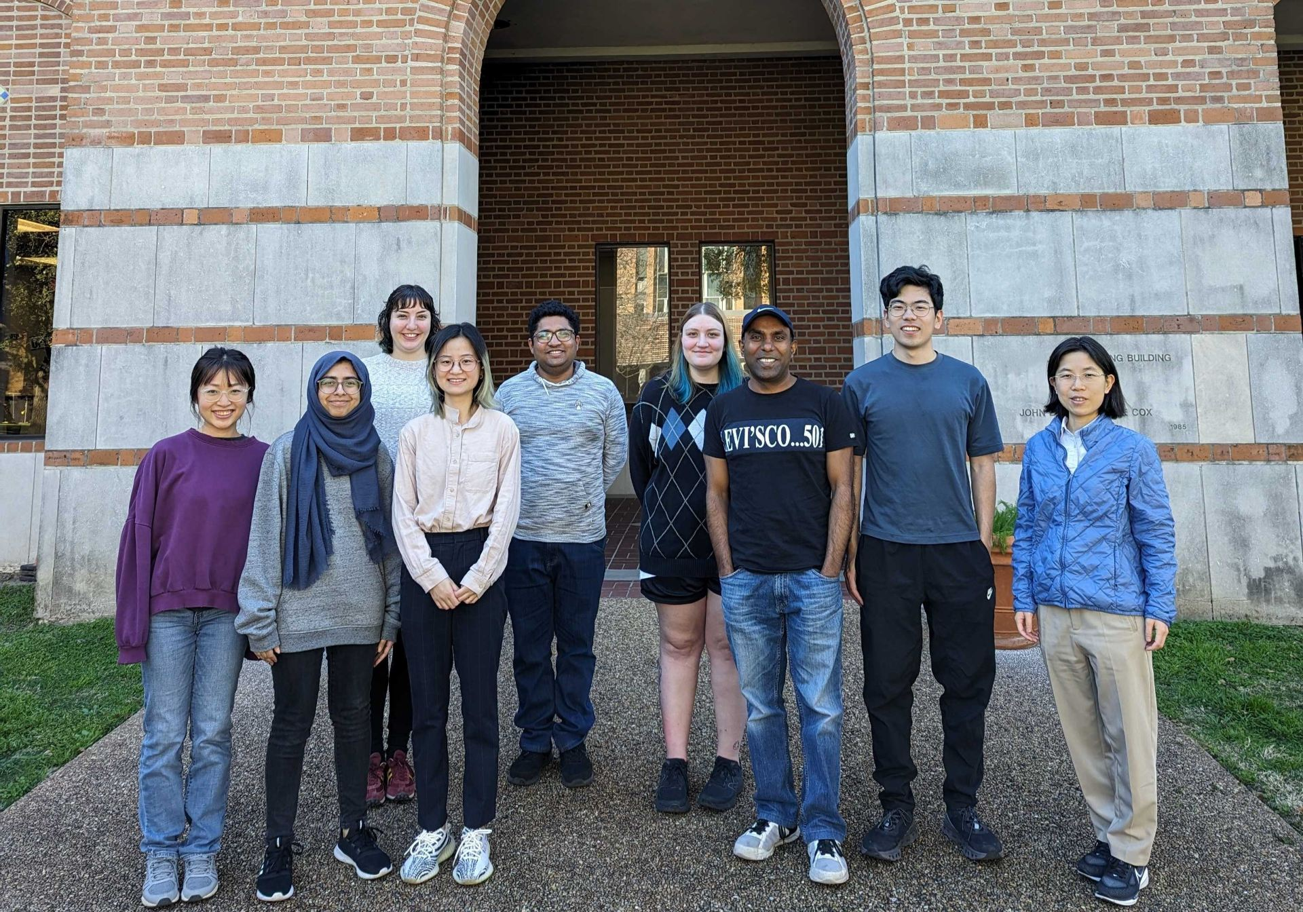
Single photon emission in 2D materials
(3) Single photon emitter creation in few layer 2D materials
Research Group: SCOPE Lab led by Prof. Shengxi Huang
Proposed to introduce effective means to mitigate the broad defect-bound excitonic emission in WSe2 and reveal the intrinsic purity limit of the single photon emitter

Slide 16
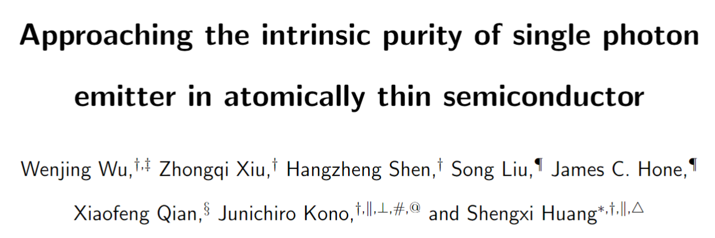
Single photon emission in 2D materials
Several problems still hinder the applications of SPEs in 2D materials in the quantum information process. The imperfections give rise to classical light emissions across a broad spectral range, overlapping with the SPE wavelength. Such emissions cannot be effectively filtered out, thereby compromising the purity of SPE emission to a degree that renders it impractical.
In this work, we employ polarization-resolved photoluminescence measurements and various g² measurement techniques to systematically investigate the purity of single-photon emitters in both monolayer and bilayer WSe2.

Slide 17
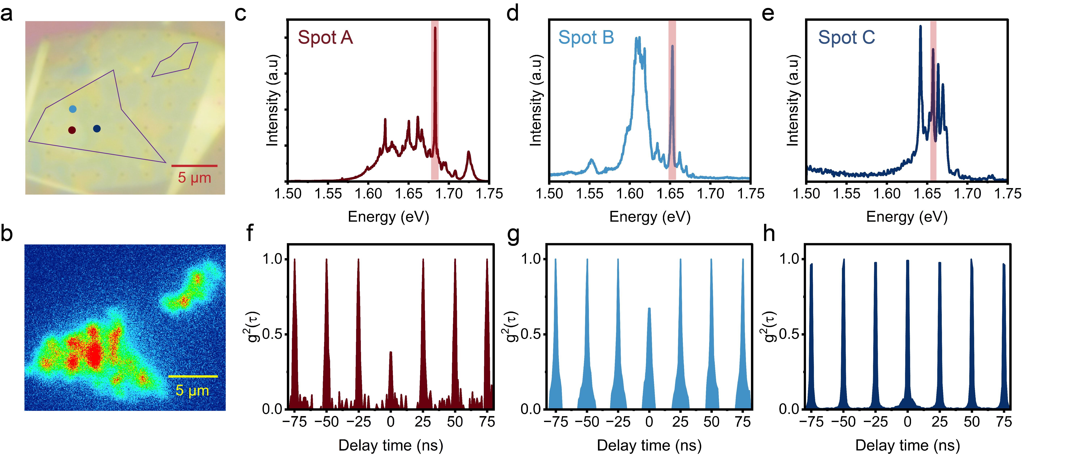
Single photon emission in 2D materials
A monolayer WSe2 flake encapsulated by thin h-BN flakes was prepared using polymer-stamp assisted dry transfer techniques and then transferred onto a Si/SiO2 substrate with predefined dielectric nanopillar array.
The grey dots are the nanopillars. Fig.b shows the PL intensity mapping of the sample at 10 K. On top of the nanopillars, the PL intensities are much higher than those of the off-pillar flat regions. Ultra-sharp and bright emissions can be seen at cryogenetic temperatures.
Notes:
The optical microscope image is shown in Fig. 2a, with WSe2 monolayer flakes outlined

Slide 18
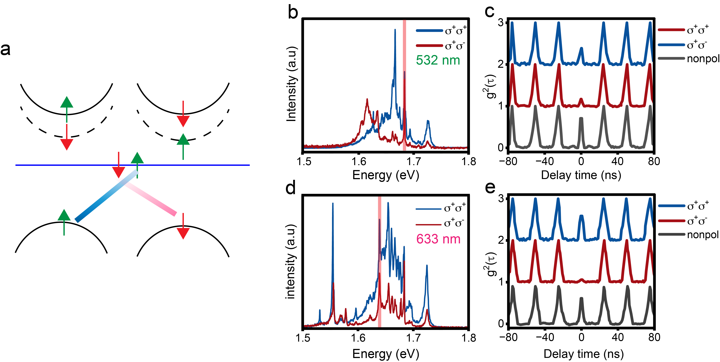
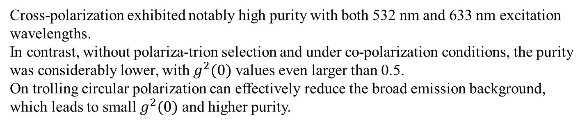
Single photon emission in 2D materials
Co-circular polarization (σ+σ+) Cross-circular polarization (σ+σ−).
Cross-polarization exhibited notably high purity with both 532 nm and 633 nm excitation wavelengths.
In contrast, without polariza-trion selection and under co-polarization conditions, the purity was considerably lower, with $g^{2}(0)$ values even larger than 0.5.
On trolling circular polarization can effectively reduce the broad emission background, which leads to small $g^{2}(0)$ and higher purity.

Slide 19
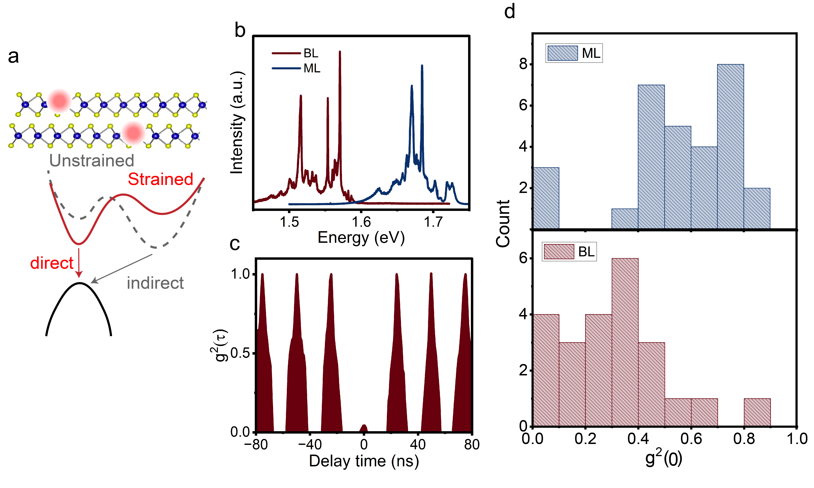
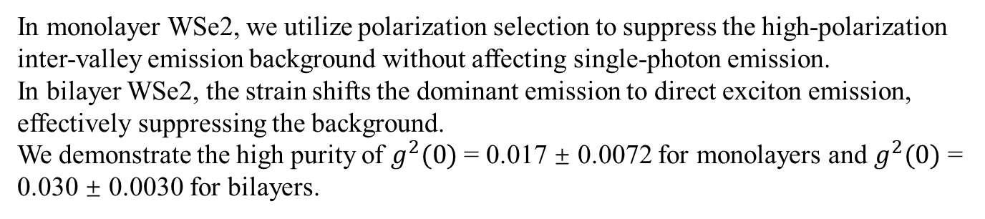
Single photon emission in 2D materials
In monolayer WSe2, we utilize polarization selection to suppress the high-polarization inter-valley emission background without affecting single-photon emission.
In bilayer WSe2, the strain shifts the dominant emission to direct exciton emission, effectively suppressing the background.
We demonstrate the high purity of $g^{2}(0)$ = 0.017 ± 0.0072 for monolayers and $g^{2}(0)$ = 0.030 ± 0.0030 for bilayers.

Slide 20
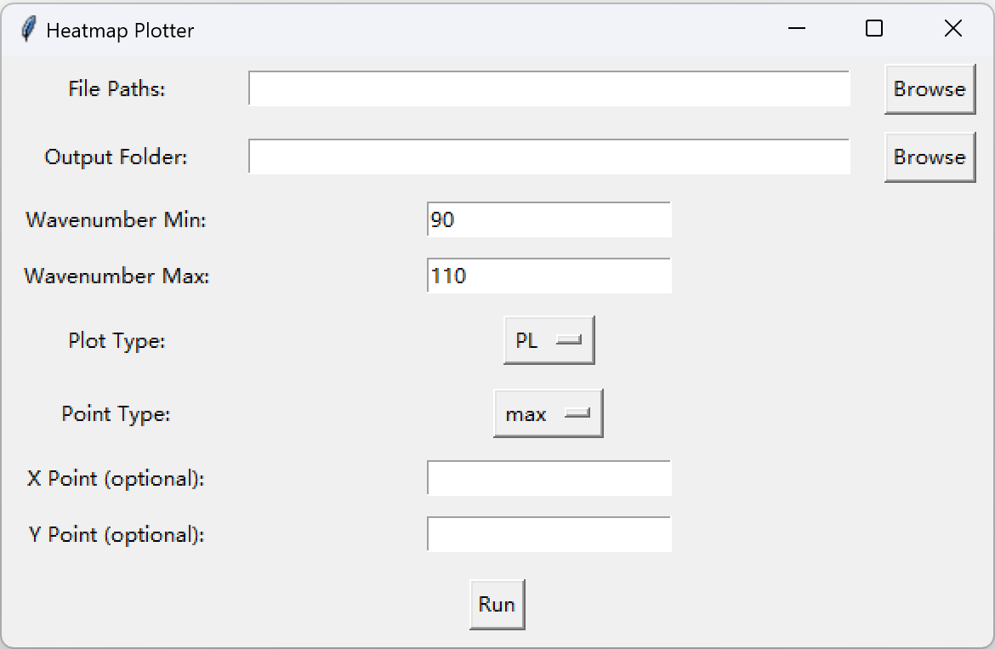
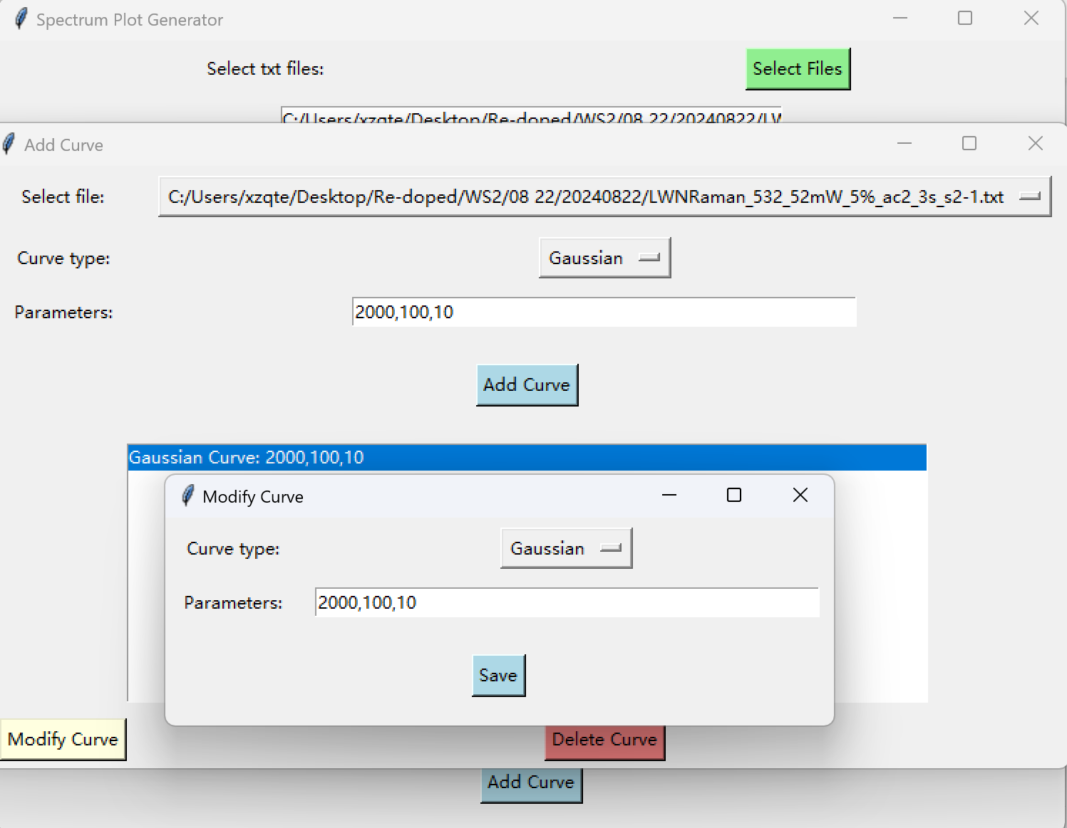
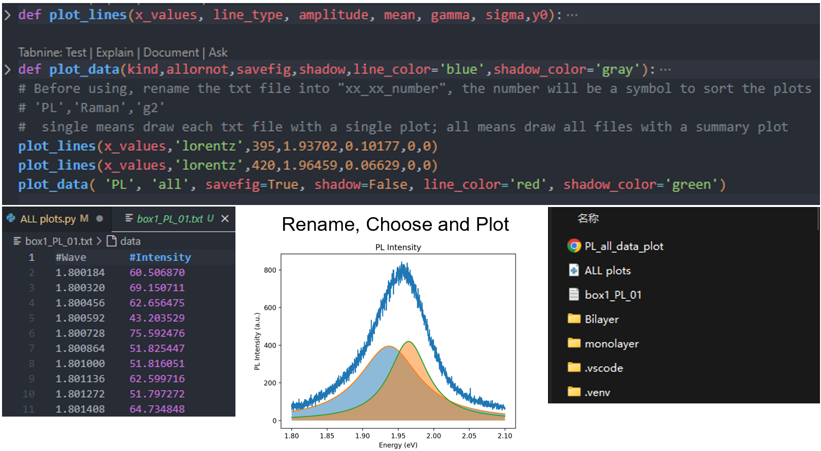
Data analyze

Slide 21
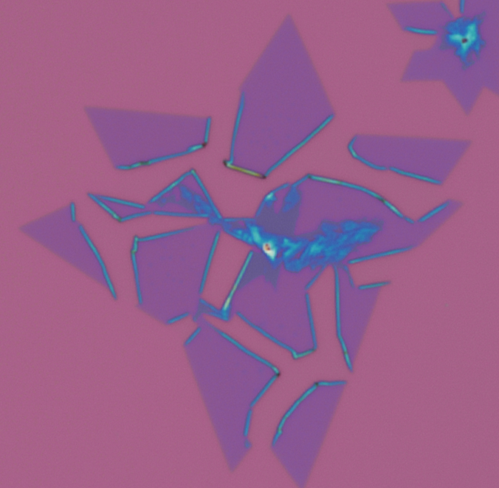
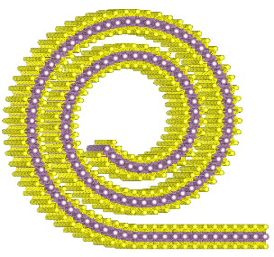
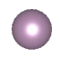
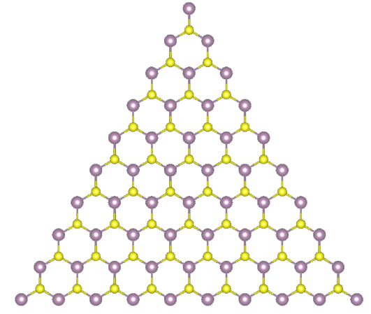
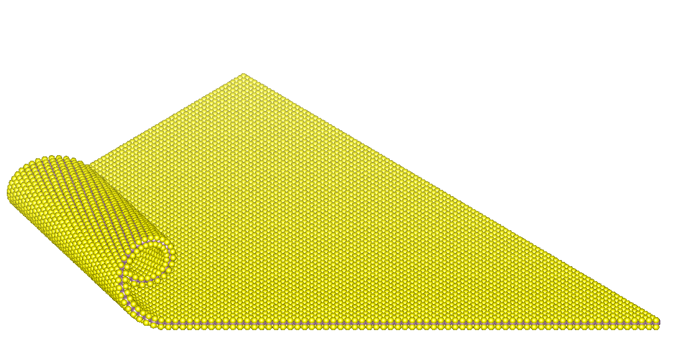

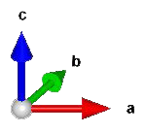
Second Harmonic Generation of Nanoscroll Array
(4) Second Harmonic Generation of MoS2 Nanoscroll Array (Doing now)
Research Group: SCOPE Lab led by Prof. Shengxi Huang
Proposed to create MoS2 nanoscroll array and get the Second Harmonic Generation with Enhanced Efficiency
y
6.4°
Mo
x
S
θ_{roll}

Slide 22
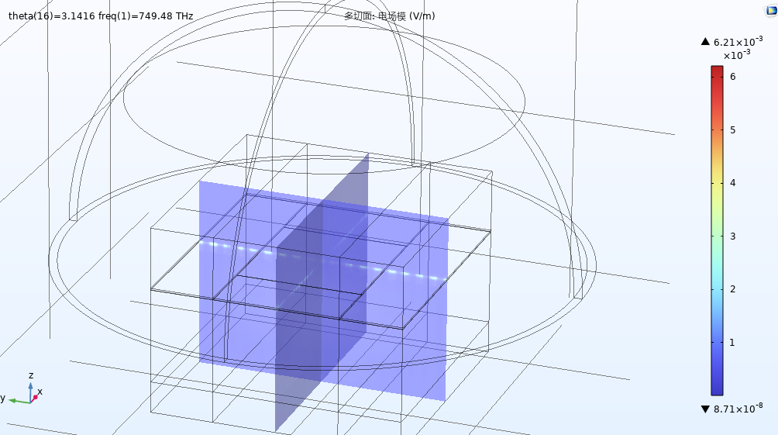
Second Harmonic Generation of Nanoscroll Array

Slide 23
Other projects
Discover physical concepts with neural networks (2021 - 2022)
Simulation and review of light field modes in Fabry–Pérot cavity (2022)
Search exotic particles with deep learning and use Random Forests to classify phases in the Ising Model (2023)
RoboGame 2023 (2023)
Simulation of the focusing property with high-NA lens of vectorial polarized beam (2024)

Slide 24
03.
Future Plan

Slide 25
About PhD
Objective :
Apply quantum optics and 2D material background to measure quantum properites of assembled materials.
Research the molecule-based strongly correlated system with molecules and 2D materials.
Develop 1D-2D and 2D-3D heterostructures for designer anisotropic electronic correlations and optical properties
Based on the resources and opportunities in the lab, I am open to refining or adjusting these plans.

Slide 26
THANKS
Applicant: Zhongqi Xiu

Slide 27
Questions
Mentor style: working time/ meetings?
Expectations for PhD students: graduate?
About the program application: which program?

Slide 28
Appendix
Background

Slide 29
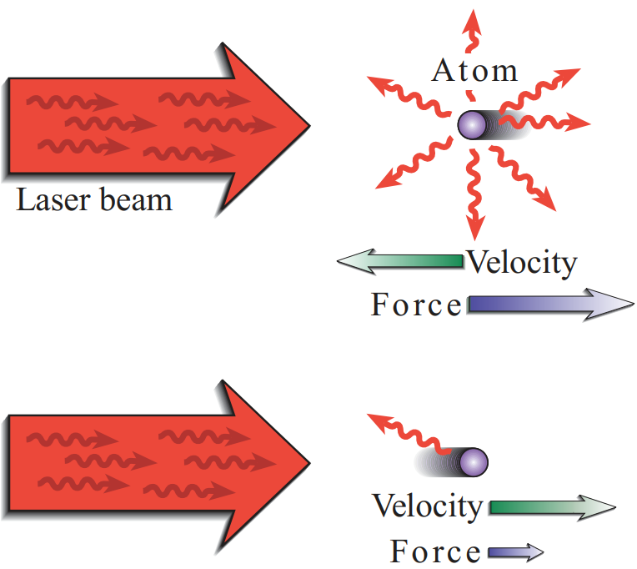
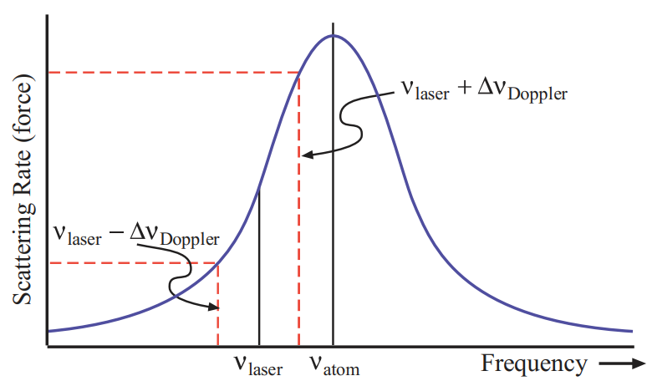
Background---Laser Cooling
Optica 4, 576-579 (2017)

Slide 30
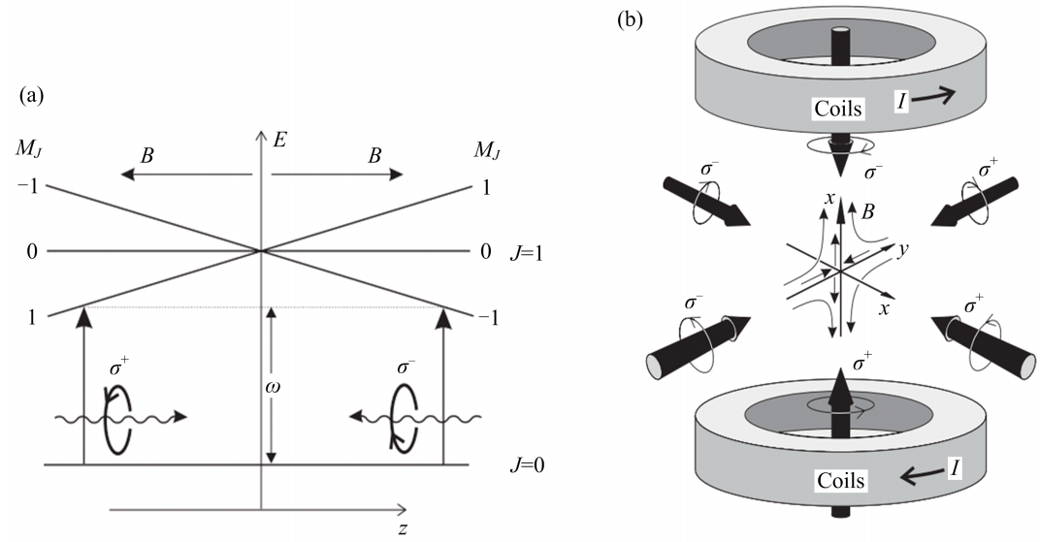
Background---MOT
Optica 4, 576-579 (2017)

Slide 31
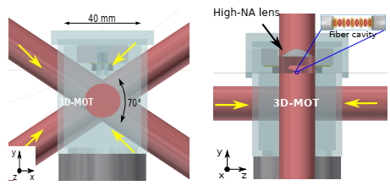
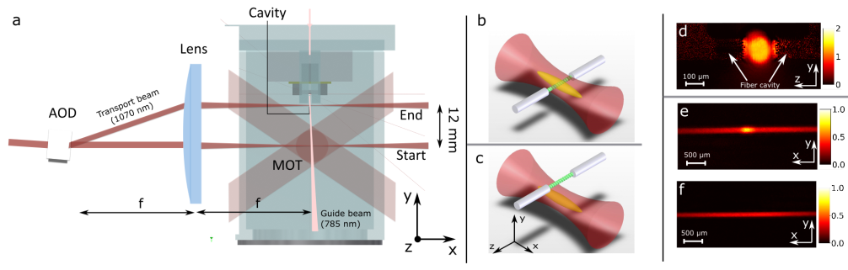
Background---MOT in Fiber Cavity
Optica 4, 576-579 (2017)

Slide 32
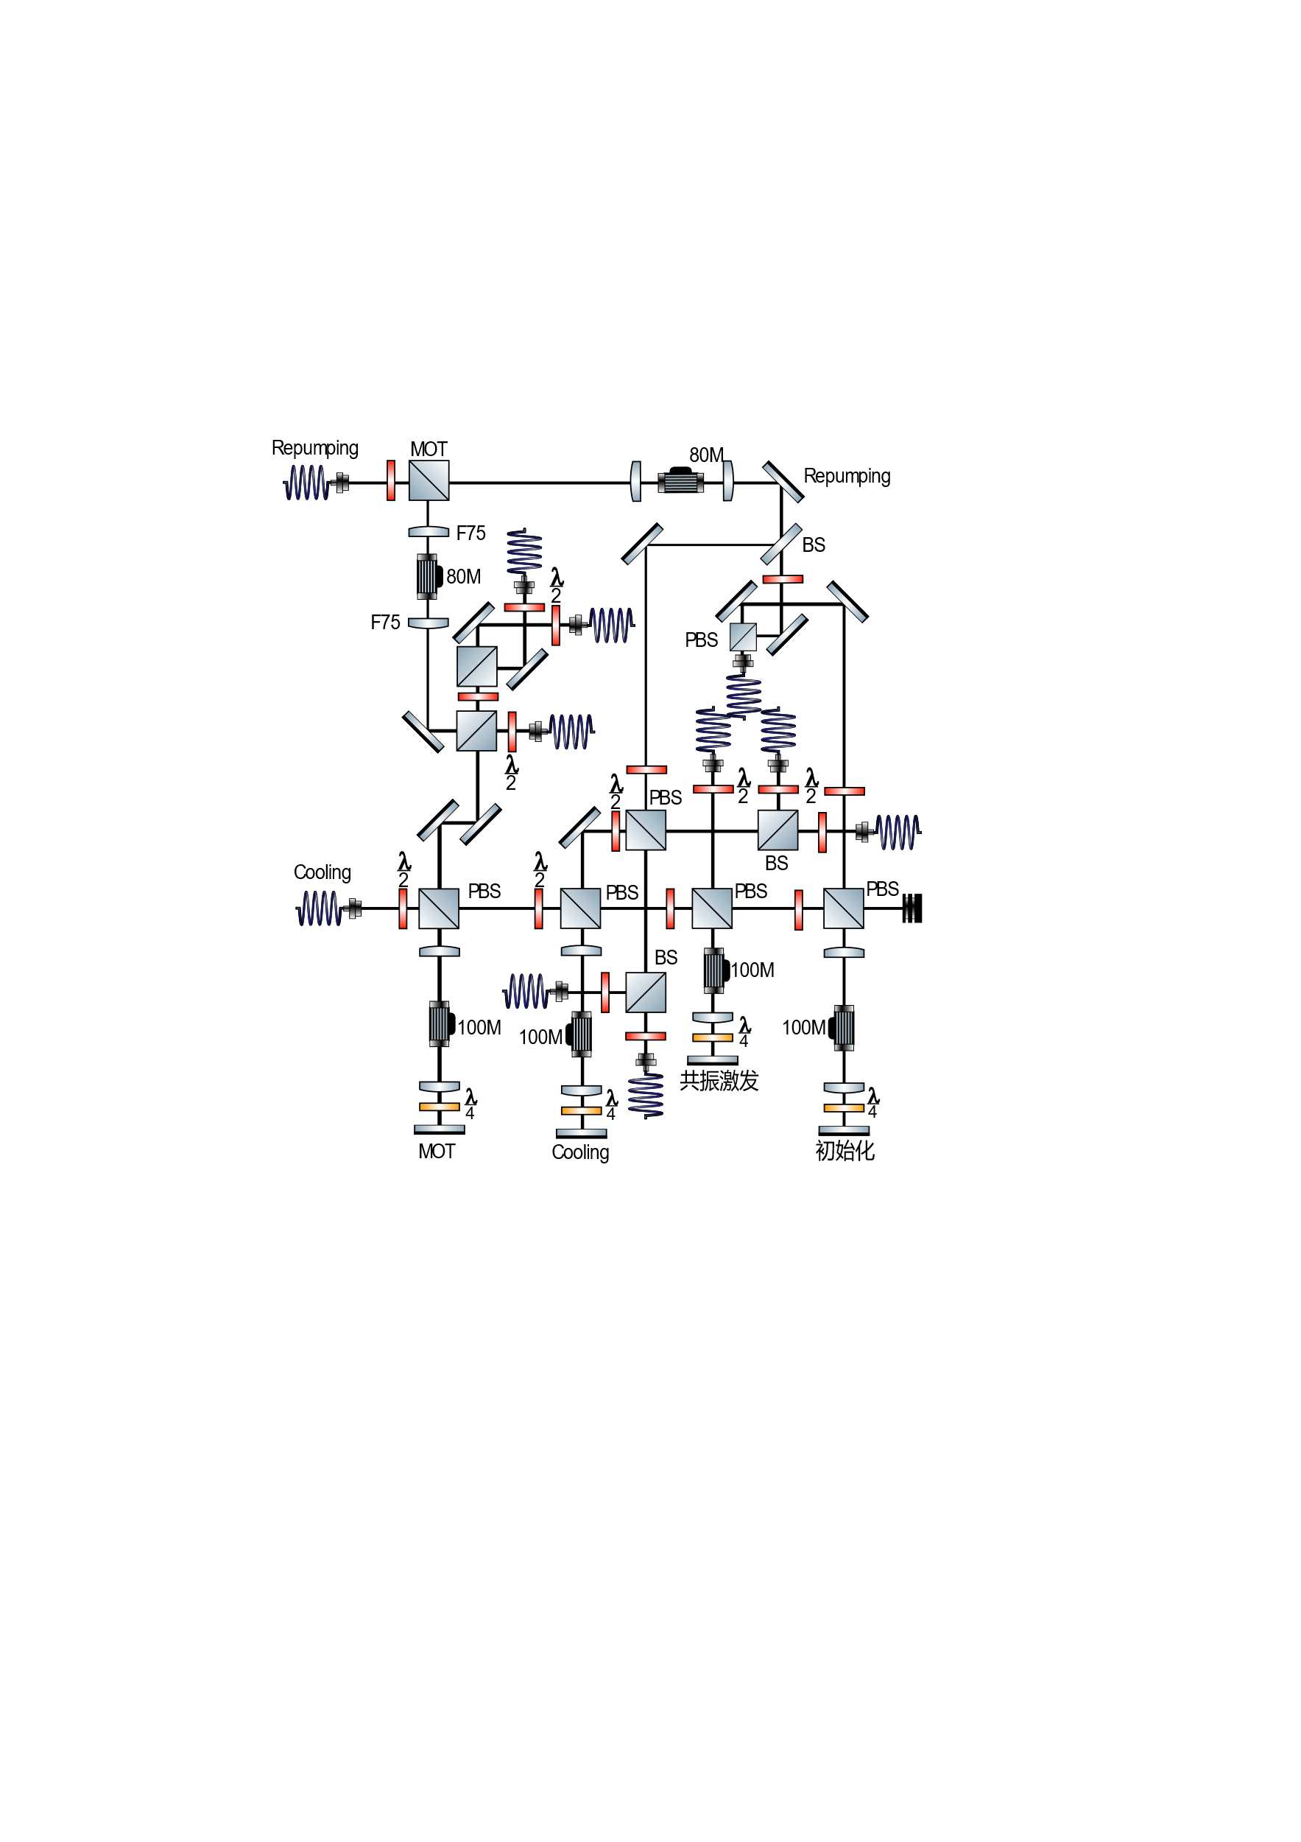
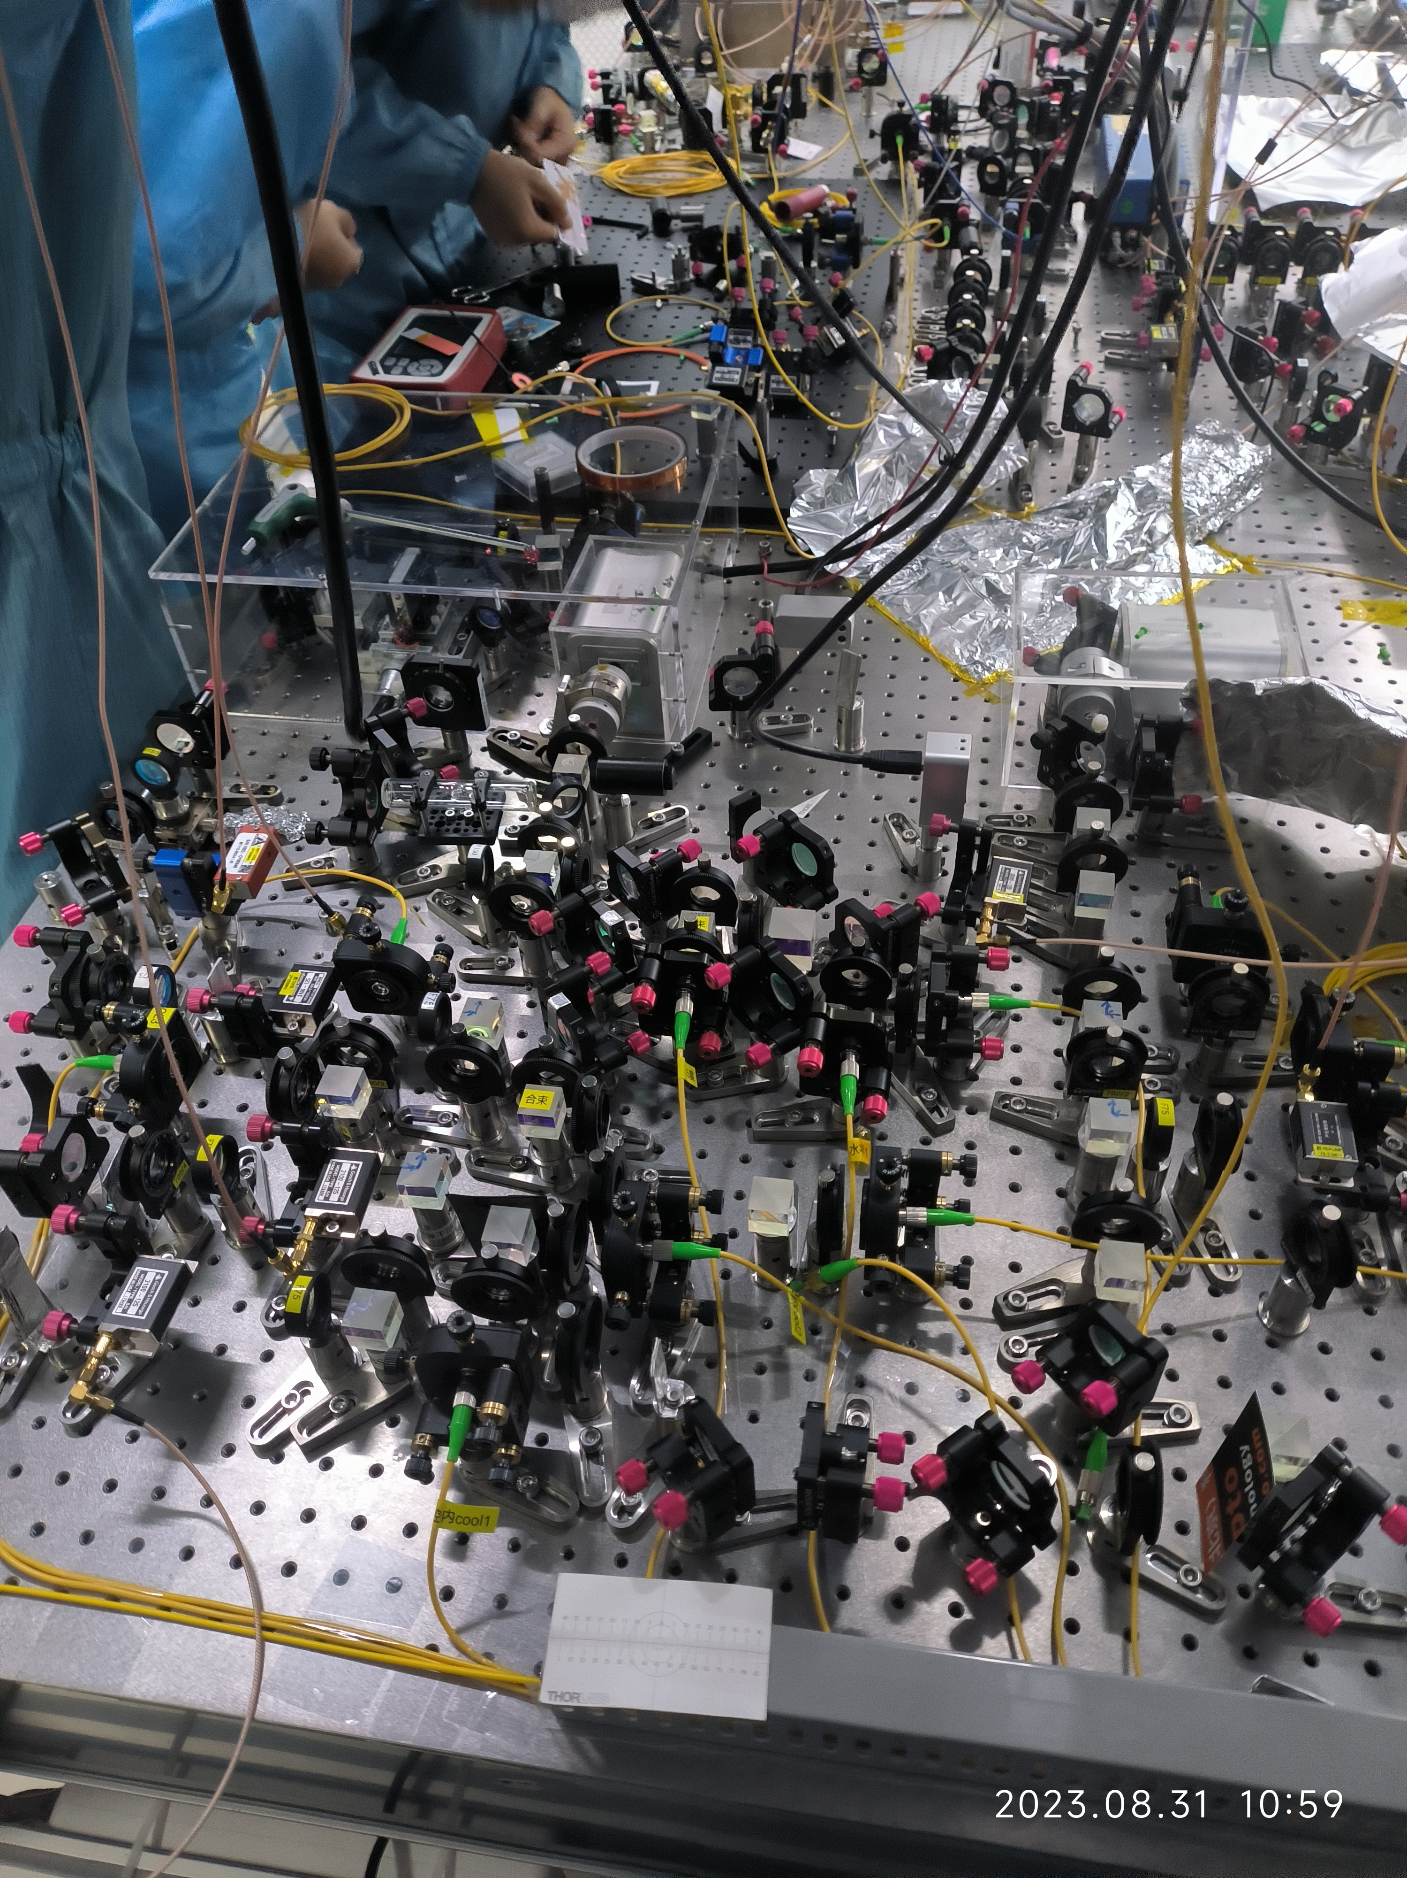
Background---Light Path

Slide 33
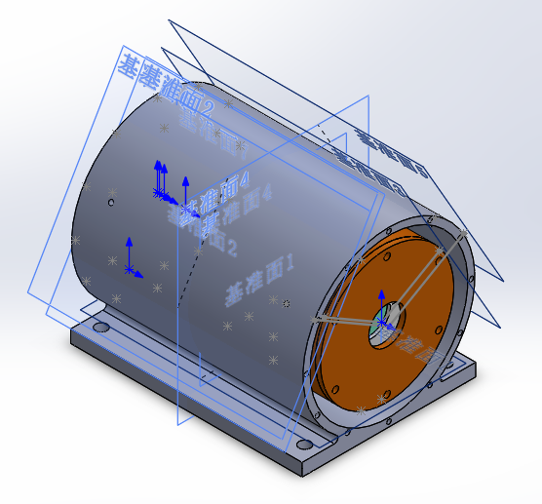
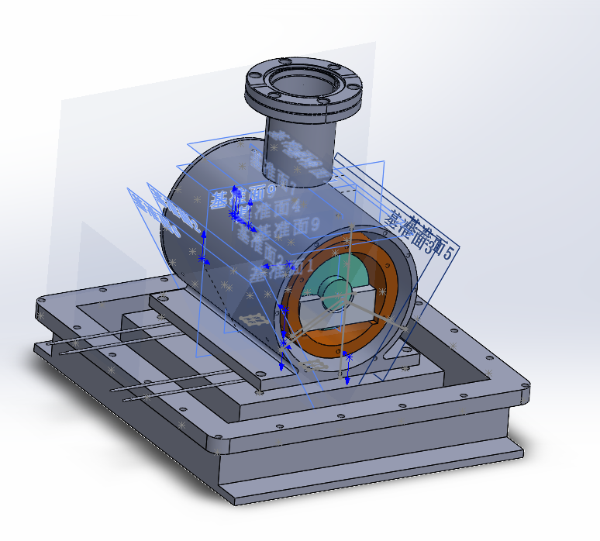
Background---Vacuum cavity design

Slide 34
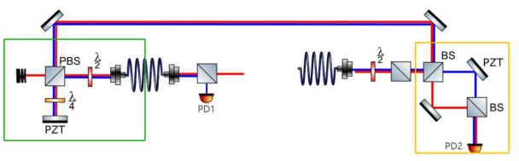
Background---Moveable optical lattice
Setup:
Red light as the left side incoming light Blue light as the right side incoming light
Adjust the position of the PZT lens to change the phase, and the side view of the light is shown (yellow frame).
Adjust the position of the PZT lens to switch between the east and west positions, thereby forming the crystal lattice.
Process:
1. Build the phase delay device on the left (green box)
2. Adjust the position of the red/blue beam
3. Build a phase-locked interferometer

Slide 35
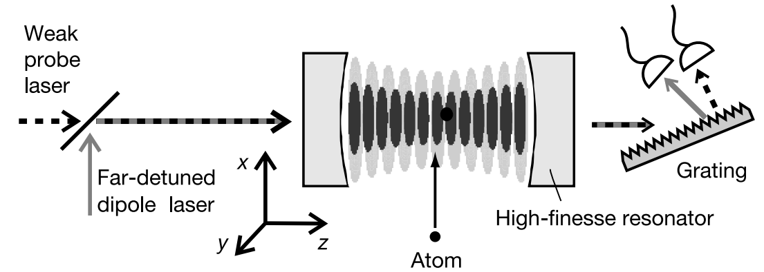
Background---Cavity cooling
Cavity cooling occurs due to the interaction between the atom and the detuned cavity field, where the atom loses kinetic energy as the cavity mode adjusts dynamically to the atom's motion.
The asymmetry in cooling versus heating processes, combined with the fact that the atom is rarely excited, allows for more efficient cooling to temperatures below the Doppler limit, constrained only by the cavity's linewidth.
Nature 428, 50–52 (2004)

Slide 36
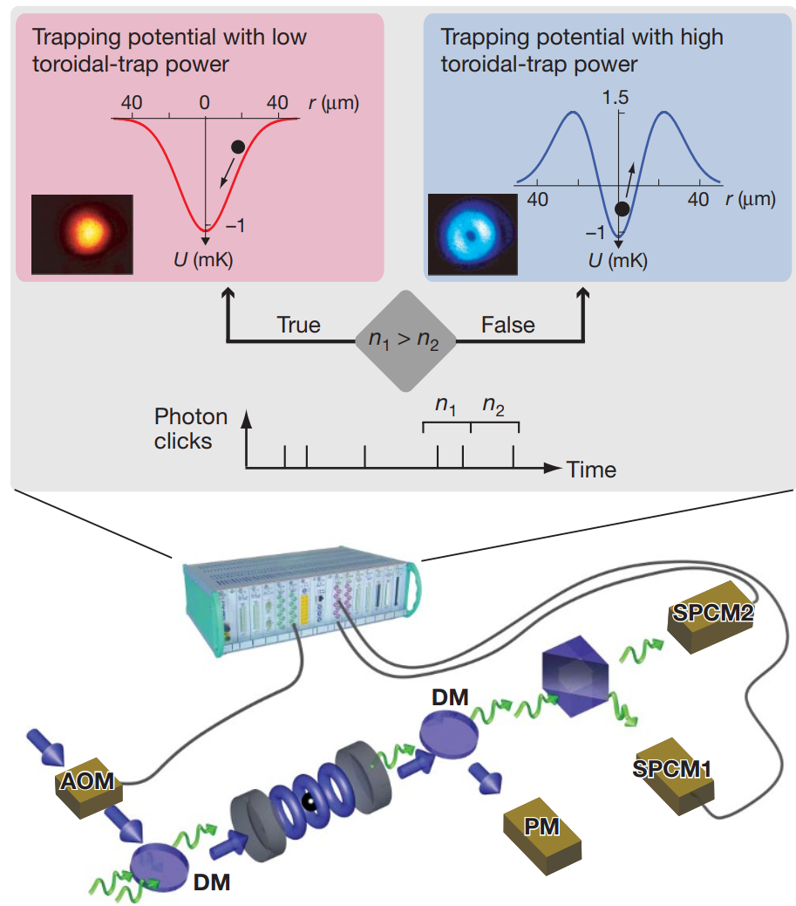
Background---Feedback cooling
Rb atoms are trapped inside a Fabry-Perot cavity The transmission during two intervals is evaluated and compared.
If the transmission during the earlier interval surpasses the transmission during the latter interval by a certain threshold, if the transmission is decreasing with time corresponding to an atom moving inwards, the dipole trap is switched low to minimize the kinetic energy gained by the atom.
If, however, the transmission difference is below that threshold, the trap depth is switched high, increasing the potential gradient for the outgoing atom.
Nature 462, 898–901 (2009)

Slide 37
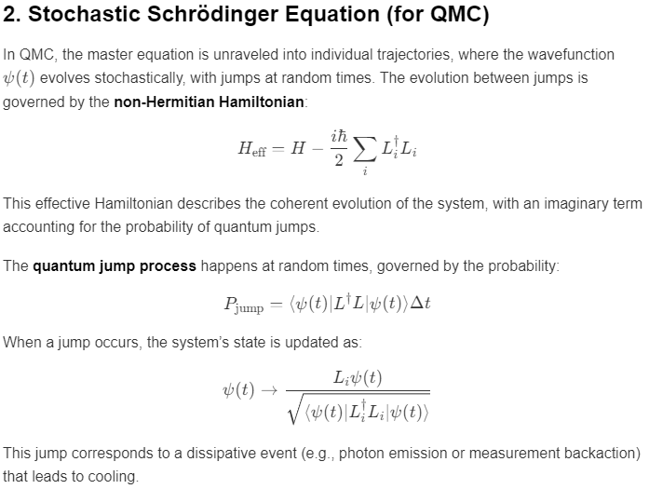
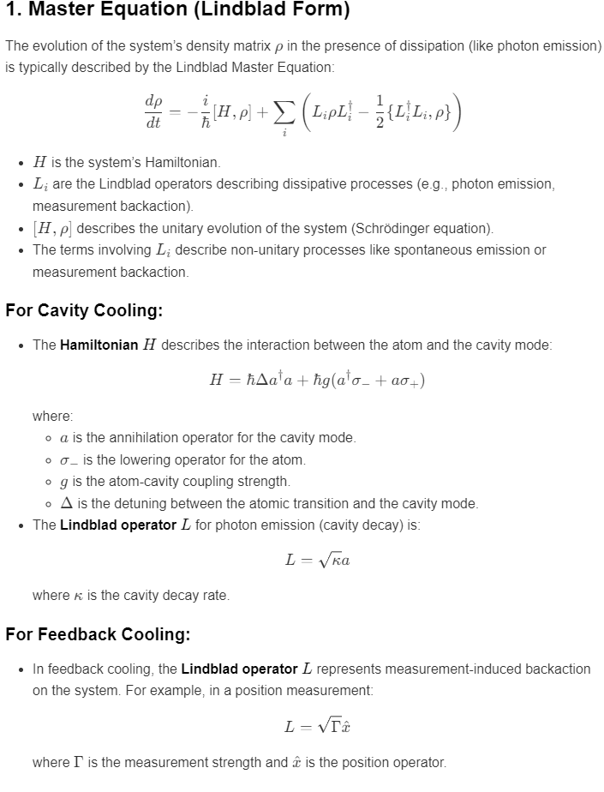
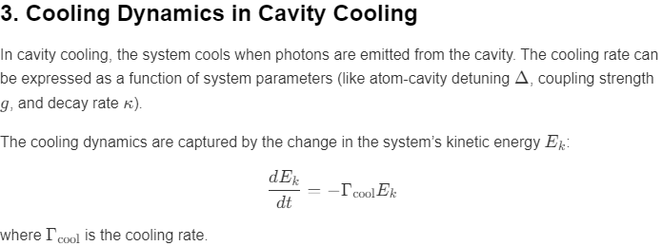
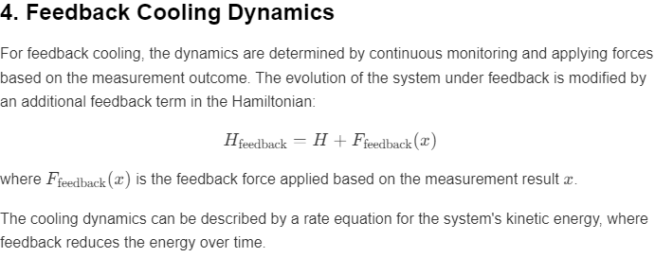
Background---Calculation

Slide 38
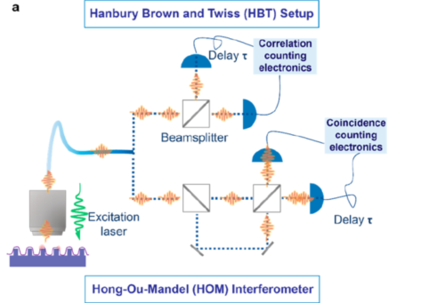
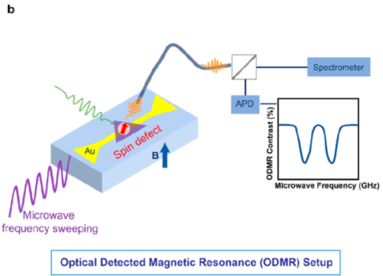
Background---Single photon emitters
Requirements for Ideal SPEs
Purity, Indistinguishability, Brightness, Reliability, Room-temperature operation …
Techniques to assess those metrics
Purity---Hanbury Brown and Twiss (HBT) interferometer
Indistinguishability--- Hong-Ou-Mandel (HOM) interference
Brightness--- photoluminescence (PL) spectroscopy
Reliability--- Optically detected magnetic resonance …
J. Phys. Chem. Lett. 14, 3274 (2023)

Slide 39
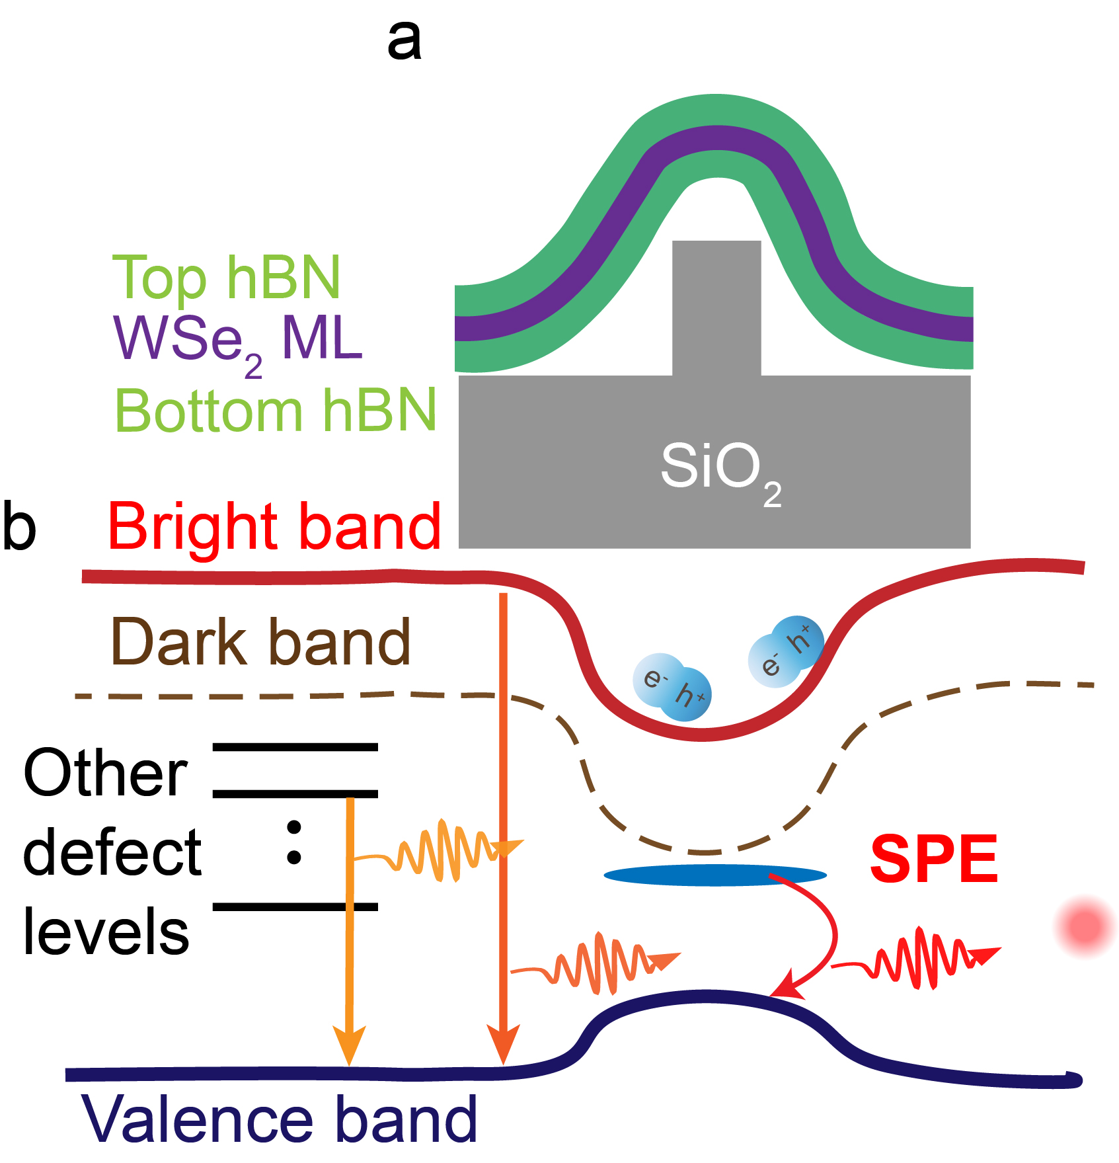
Background---Single photon emission
Schematic of strained WSe2 monolayer encapsulated between top and bottom hBN onnanopillar substrate.
Spatial variation of bandgap due to strain, the solid red(navy) linerepresents the excitonic bright(valence) band, and the dashed yellow line indicates the darkexcitonic band. Blue and black lines below the dark excitonic band denote defect-relatedlevels.
Excitons labeled as e-h pairs funnel to lower energy potential created by strain. The strain-localized dark exciton is mixed with a defect level (blue line), forming a bright single-photon emission (red outgoing arrow). Yellow (orange) outgoing arrows denote other defect-bounded (bright)exciton emissions.
Notes:
Single-photon emission has a second-order correlationfunction g(2)(τ ) < 0.5.

Slide 40



Single-photon emission and characterization
$$g^{2}\left(τ\right)=\frac{\left\langle {\hat{a}}^{\text{†} }{(t){\hat{a}}^{\text{†} }{\left(t+τ\right)}^{ }{\hat{a}}^{ }{\left(t+τ\right)}^{ }{\hat{a}}^{ }(t)}^{ }\right\rangle }{\left\langle {\hat{a}}^{\text{†} }{(t)}^{ }{\hat{a}}^{ }{(t)}^{ }\right\rangle \left\langle {\hat{a}}^{\text{†} }{(t+τ)}^{ }{\hat{a}}^{ }{(t+τ)}^{ }\right\rangle }$$
Repeat rate :T
Respond probability :Q Collection efficiency :η
Brightness: Q·η/T
$$Purity=tr\left[ρ_{φ}^{2}\right]$$
$$ρ_{φ}=\sum_{k}{q_{k}\left.|1;φ_{k}\right\rangle \left\langle 1;φ_{k}|\right.}$$
Appl. Phys. Lett. 118, 240502 (2021)

